Slide 1

The Influence of Microstructure on Growth of Fatigue Cracks in Resistance Spot Welded 6111 Aluminum Alloys
Vir S. Nirankari¹, Mei Li², John E. Allison¹
¹ University of Michigan - Ann Arbor, MI, Materials Science and Engineering Department
² Ford Motor Company, Dearborn, MI
3 June 2013

Slide 2
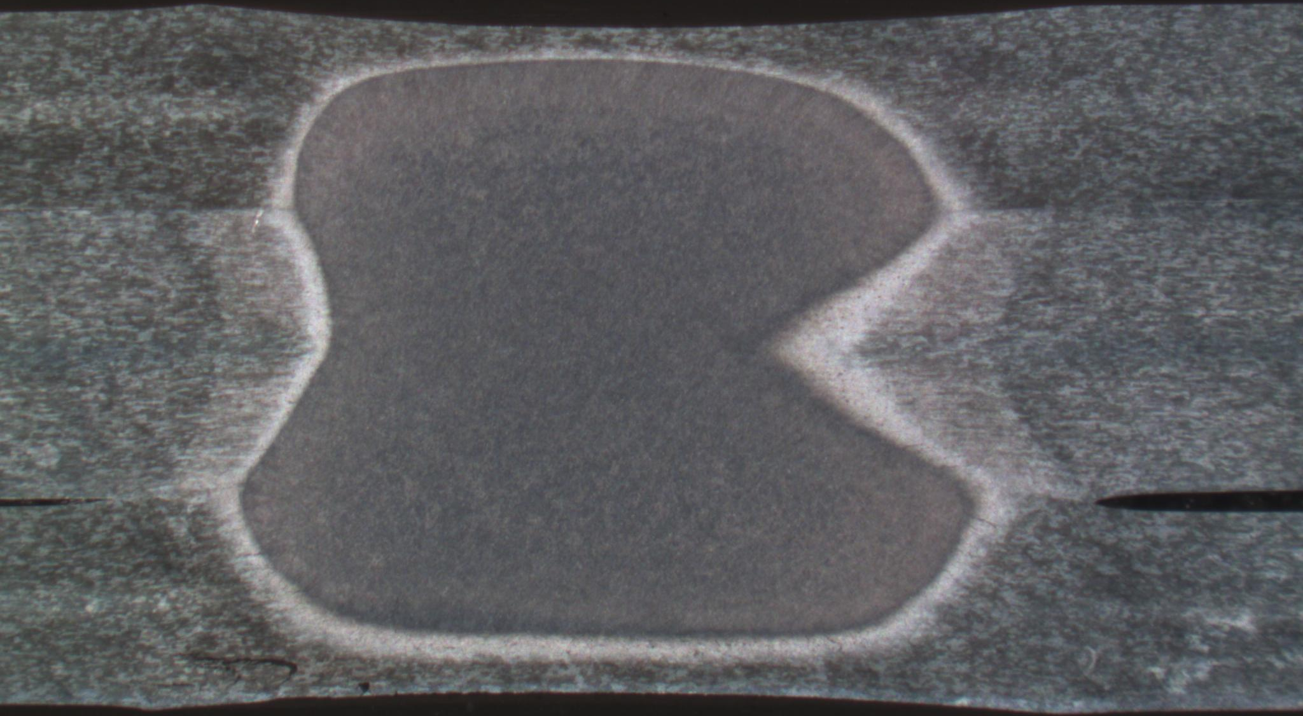
Goals
Determine crack growth rates of small fatigue cracks in the fusion zone, heat-affected zone and base material of the resistance spot welded aluminum
Accomplished with constant amplitude uniaxial fatigue testing
Crack growth is measured optically
Understand the influence of the microstructure on the fatigue crack growth rate
Apply a new model to
small fatigue crack growth
2 mm

Slide 3
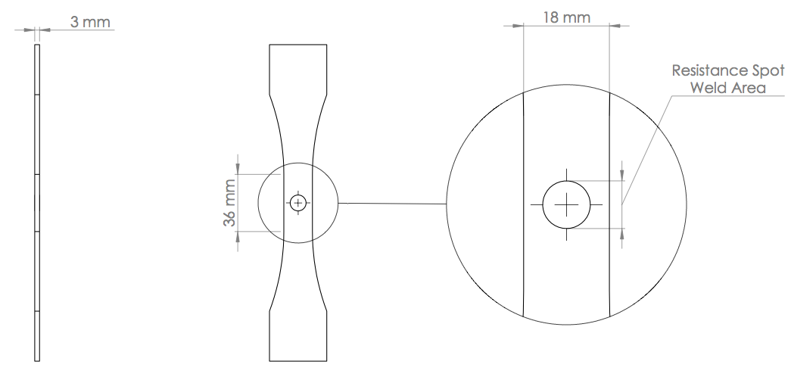
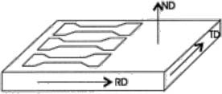
Sample Design
Loading
Direction
*
Femtosecond Laser Notch
*Pang, J.W.L., et. al., Acta Materialia 48 (2000) 1131-1140
Notes:
-point out dims
Weld nugget will be ~ 8 mm diameter
Heat-affected zone adds another 8 mm to the overall diameter
Give two mm of leeway: gage width = 18mm
Followed ASTM standards [E466-07] for force-controlled constant amplitude axial fatigue testing
-Mechanically ground/polished to 1um

Slide 4
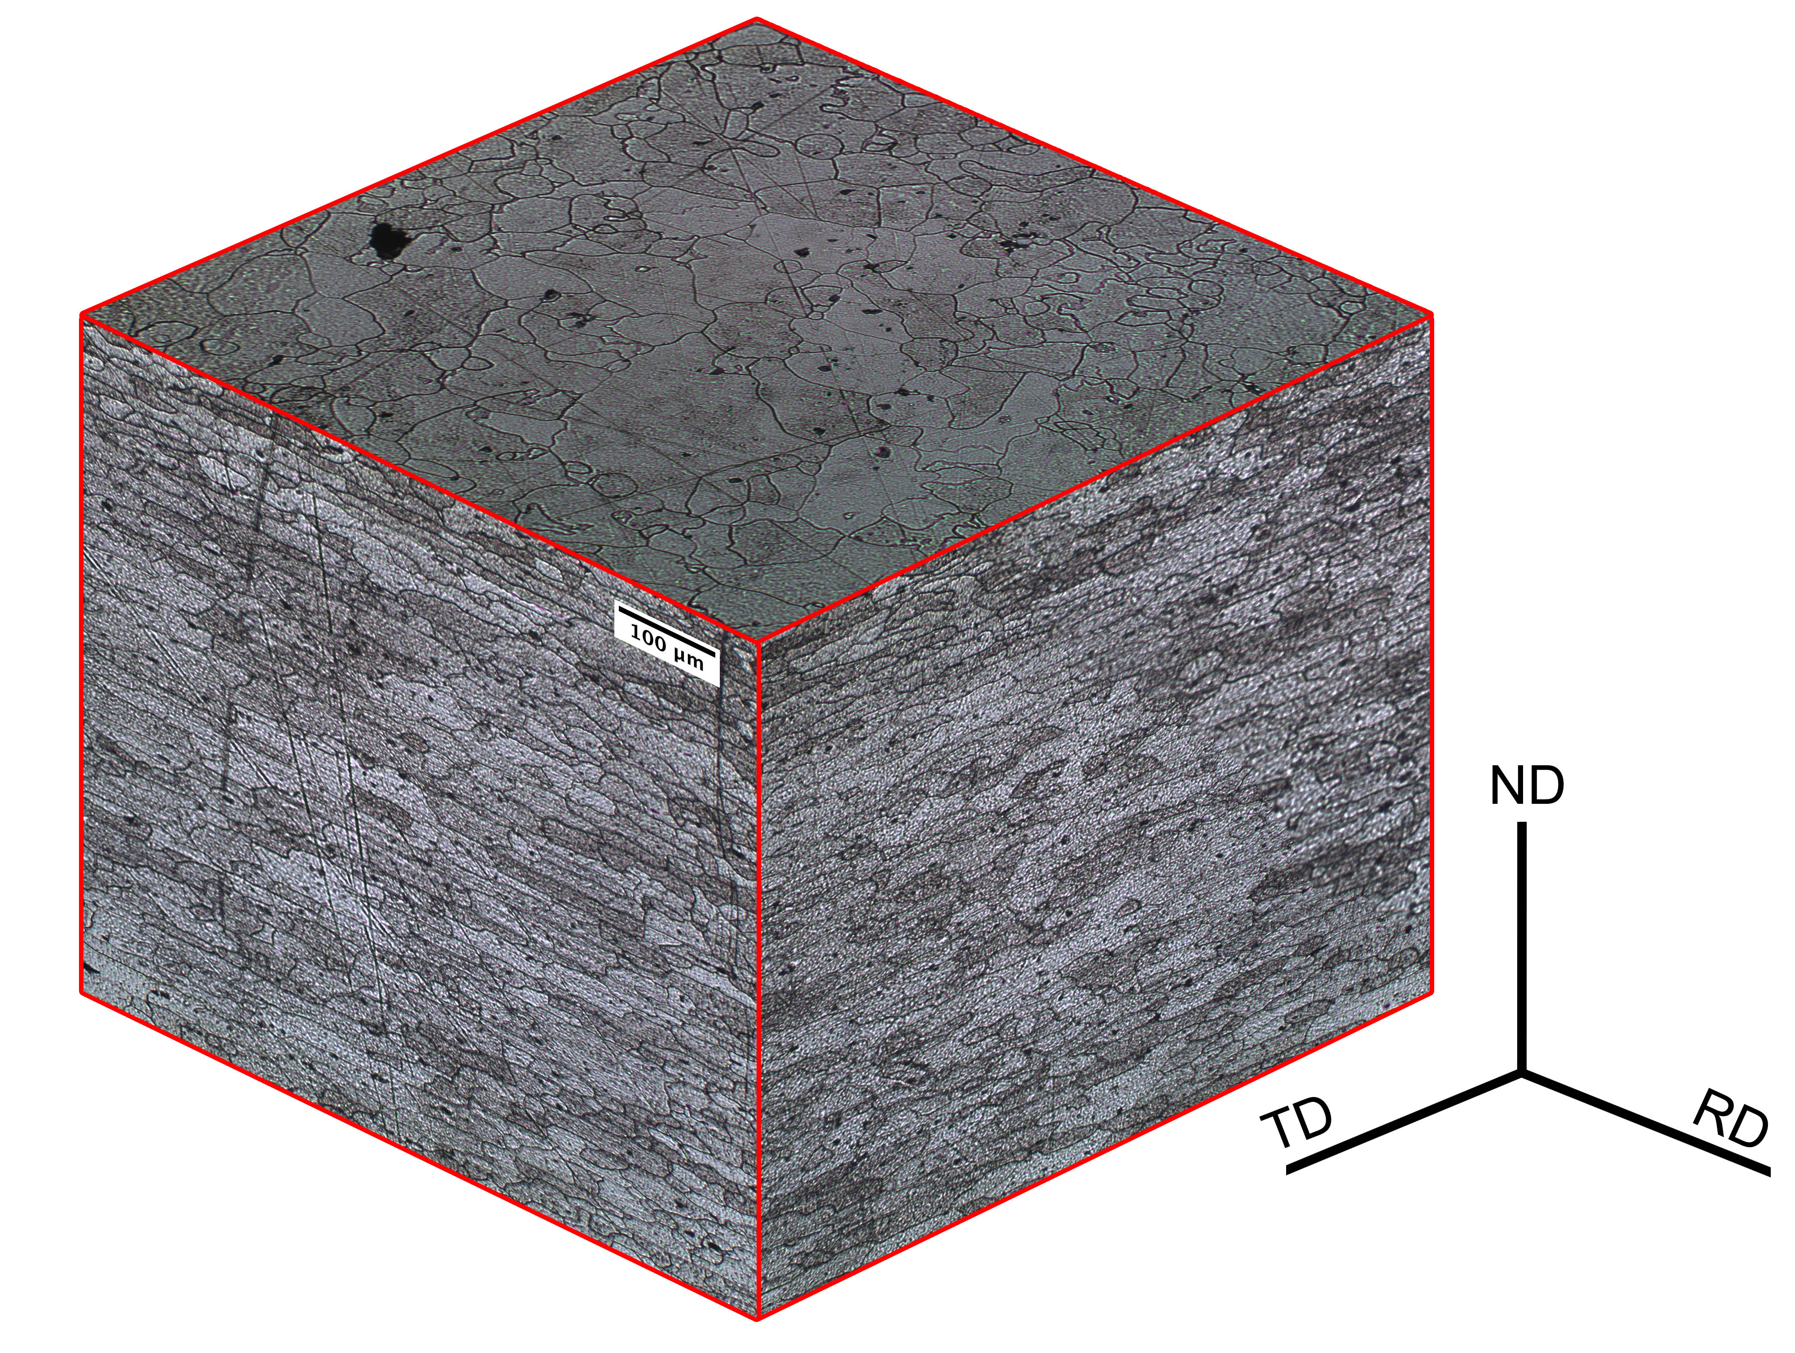
AA6111 (T4 and PB) Sheet Microstructure
Equiaxed pancake shaped grains on the
Surface ( d ~ 50 µm)
Elongated grains in the rolling and
transverse directions
300 µm
Notes:
-show 1 cube and talk about it

Slide 5
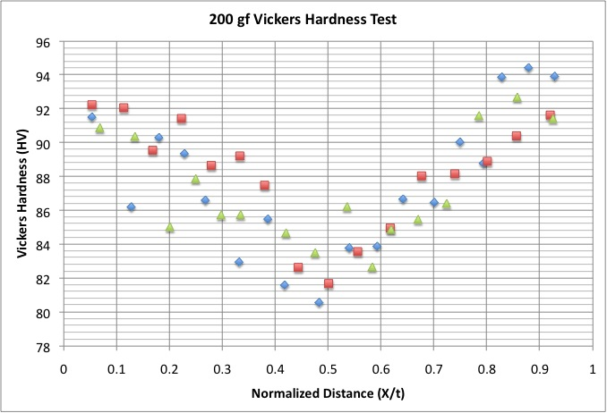
Sheet Center MicroHardness
MicroHardness Testing Direction (X)
RD
ND
150 µm
Notes:
-add sample diagram to show microhardness in macroscale

Slide 6
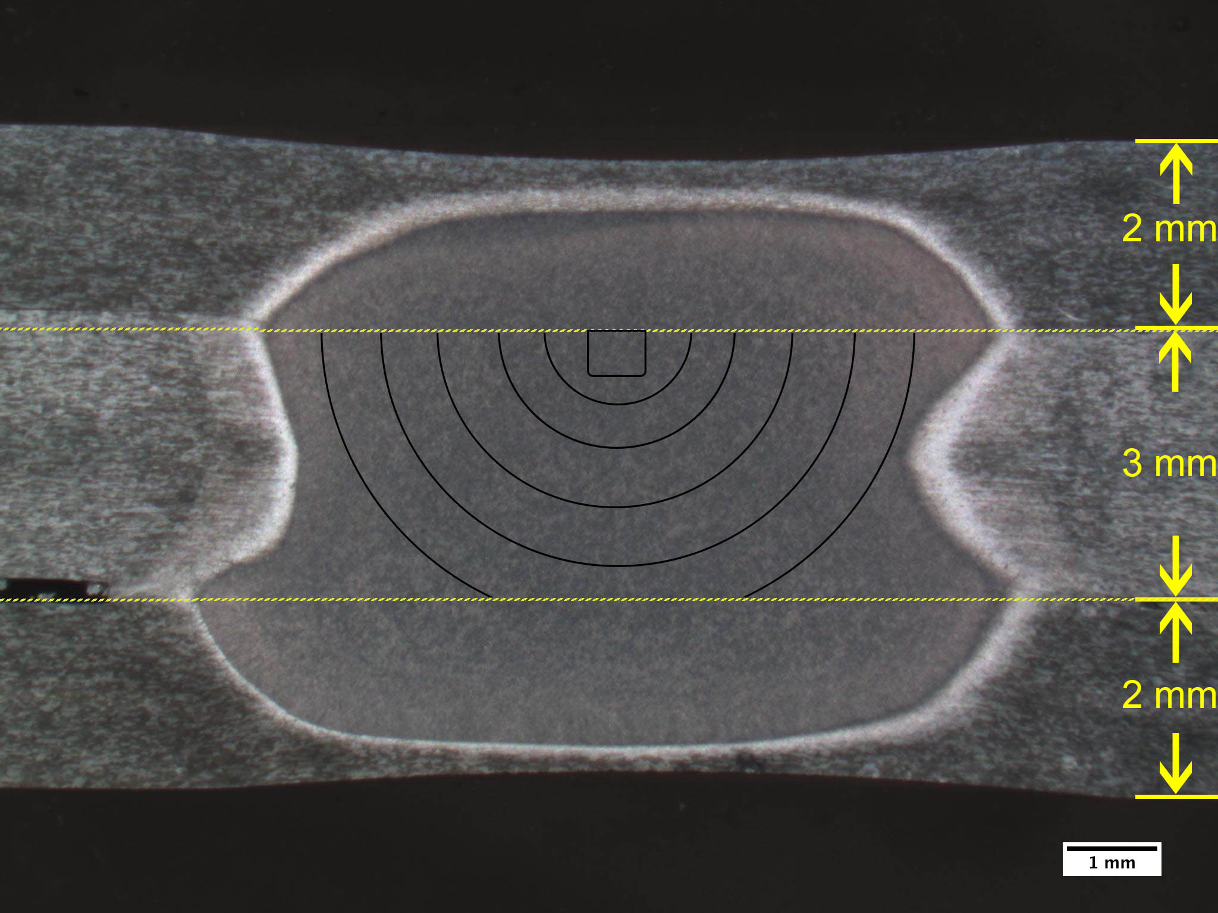
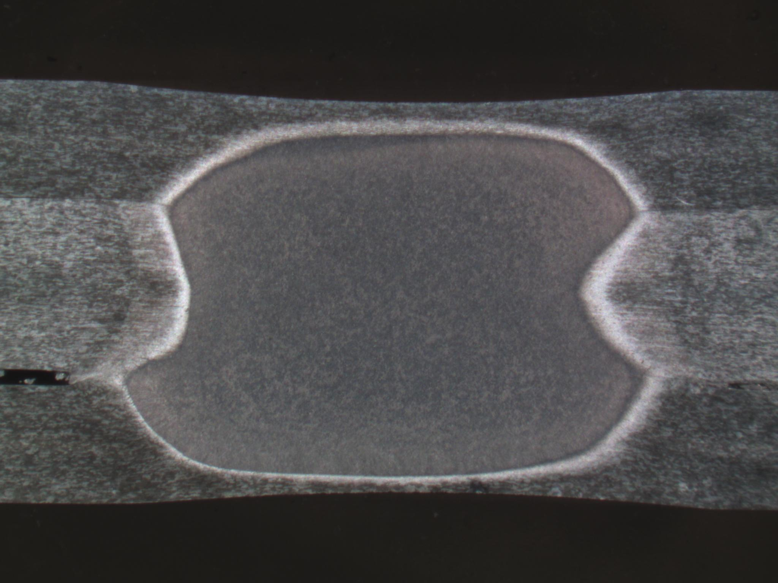


Resistance Spot Welding (RSW)
Fatigue Crack-Front Profiles
Sheet Milling
Femtosecond Notch
Femtosecond Laser Notch
Sheet
Thickness
2 mm

Slide 7
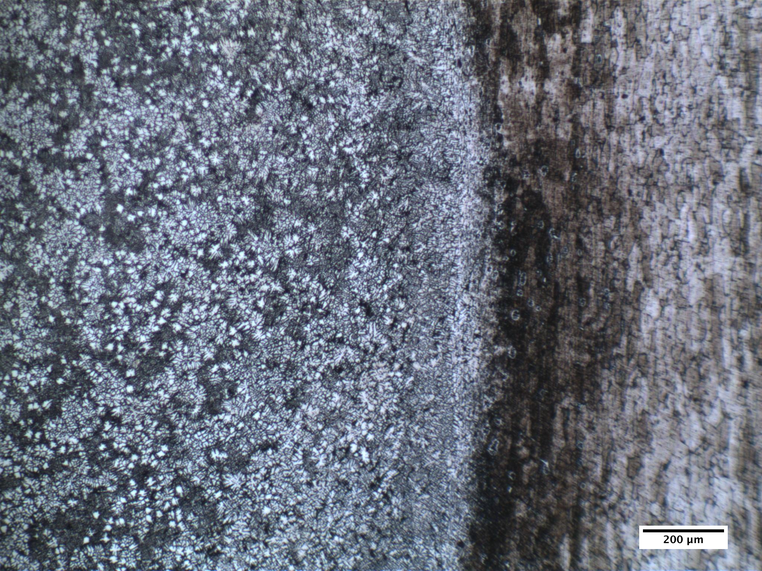
Resistance Spot Weld Microstructure
Partially Melted Zone (PMZ)
Base Material
(BM)
Fusion Zone (FZ)
Cellular-dendritic microstructure in the fusion zone
Heat-Affected Zone (HAZ)
200 µm
Notes:
-HAZ:close to BM through thickness: 75 x 25 um (AR ~ 3)
Inconclusive, theory says there should be growth of ppts in this zone, weaker than BM

Slide 8
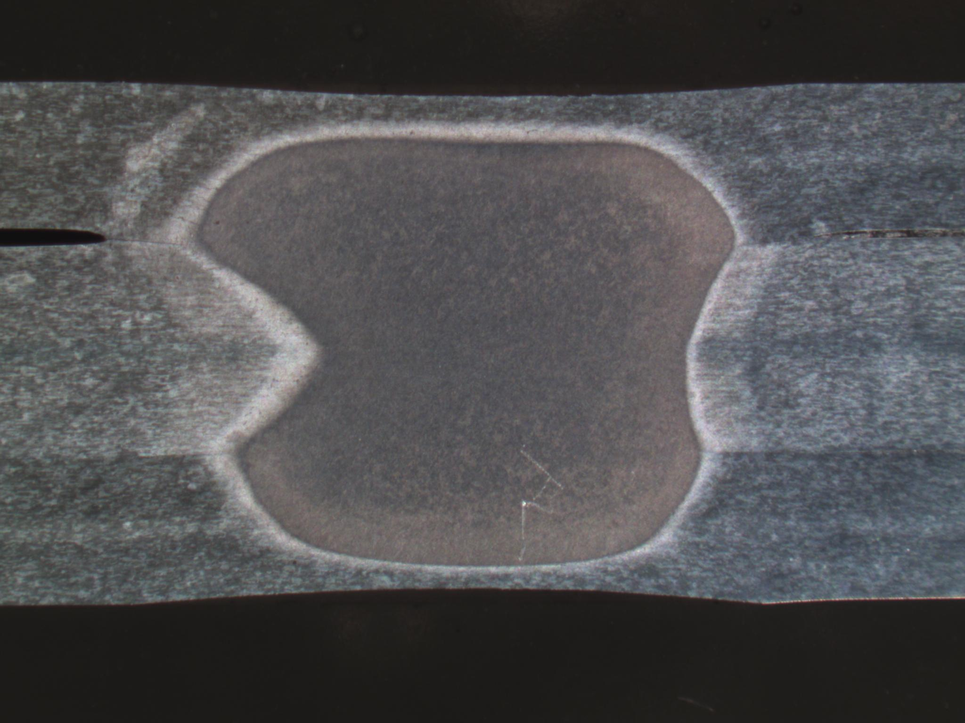
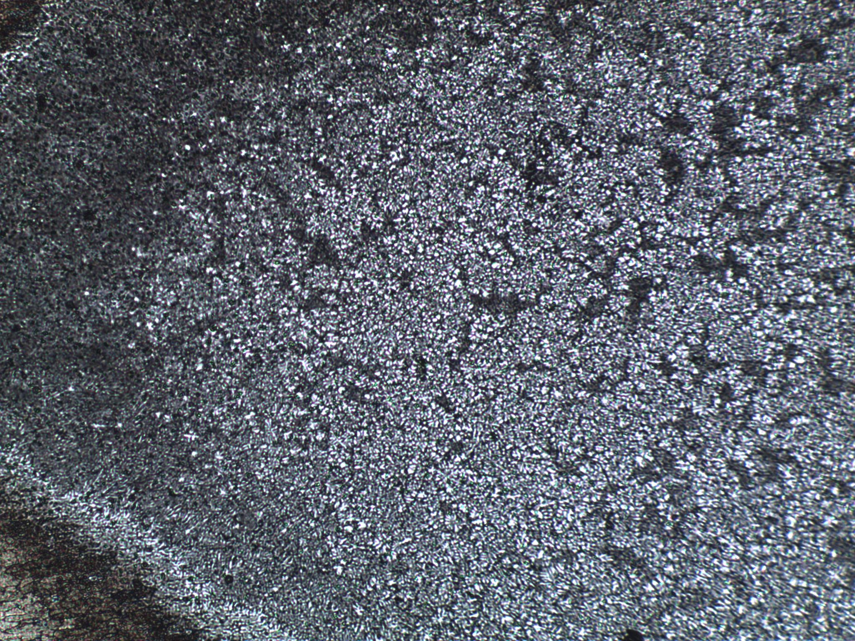
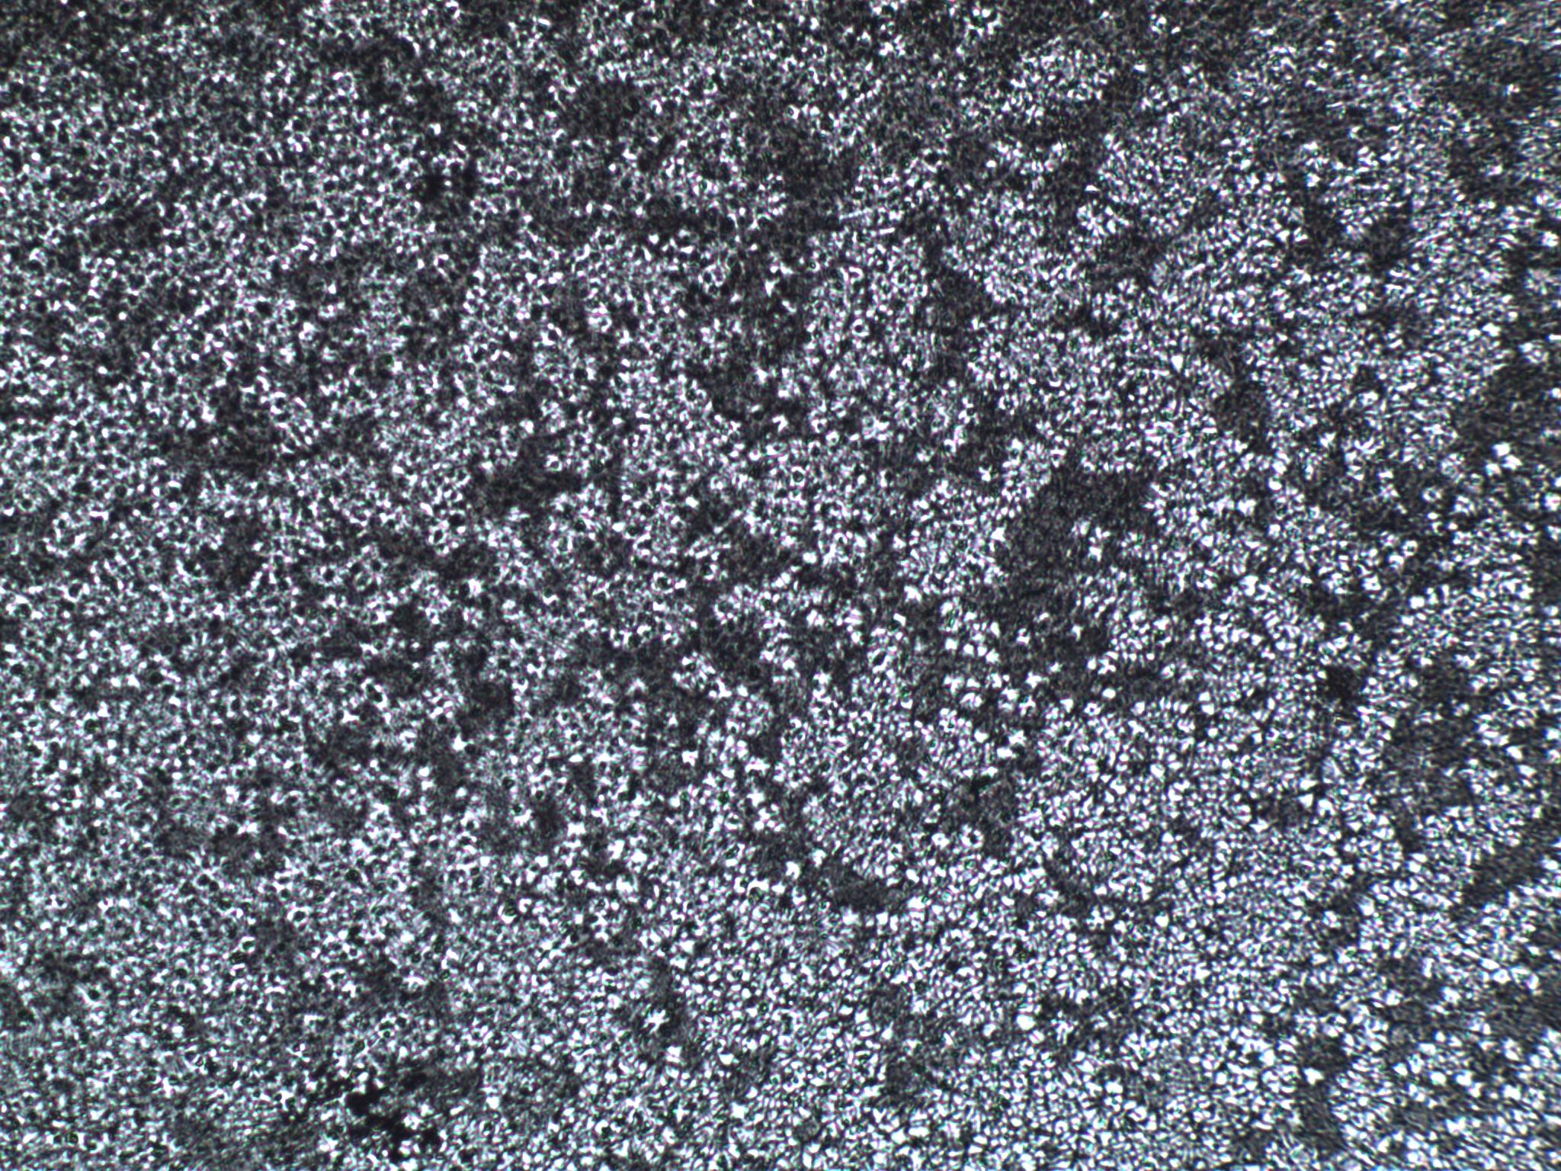
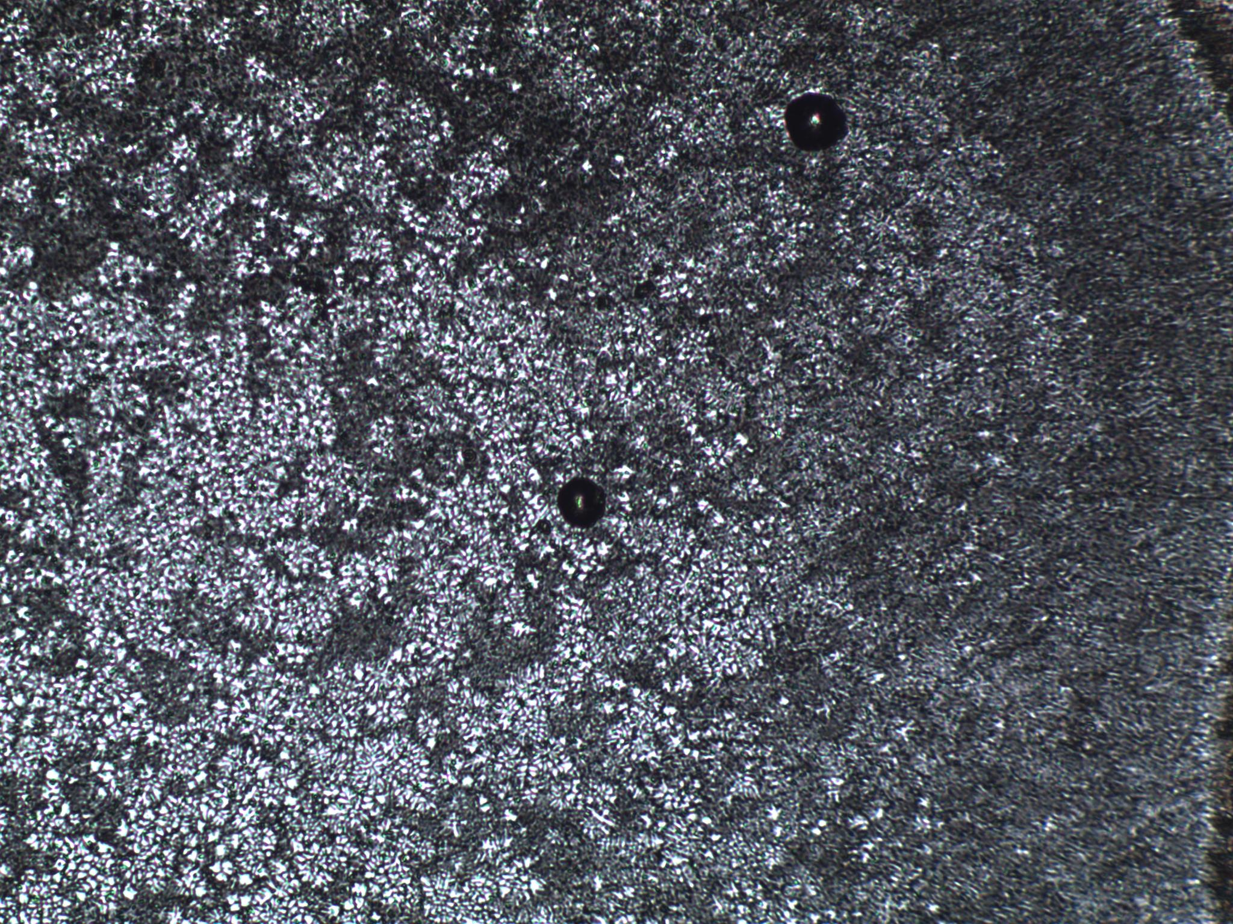
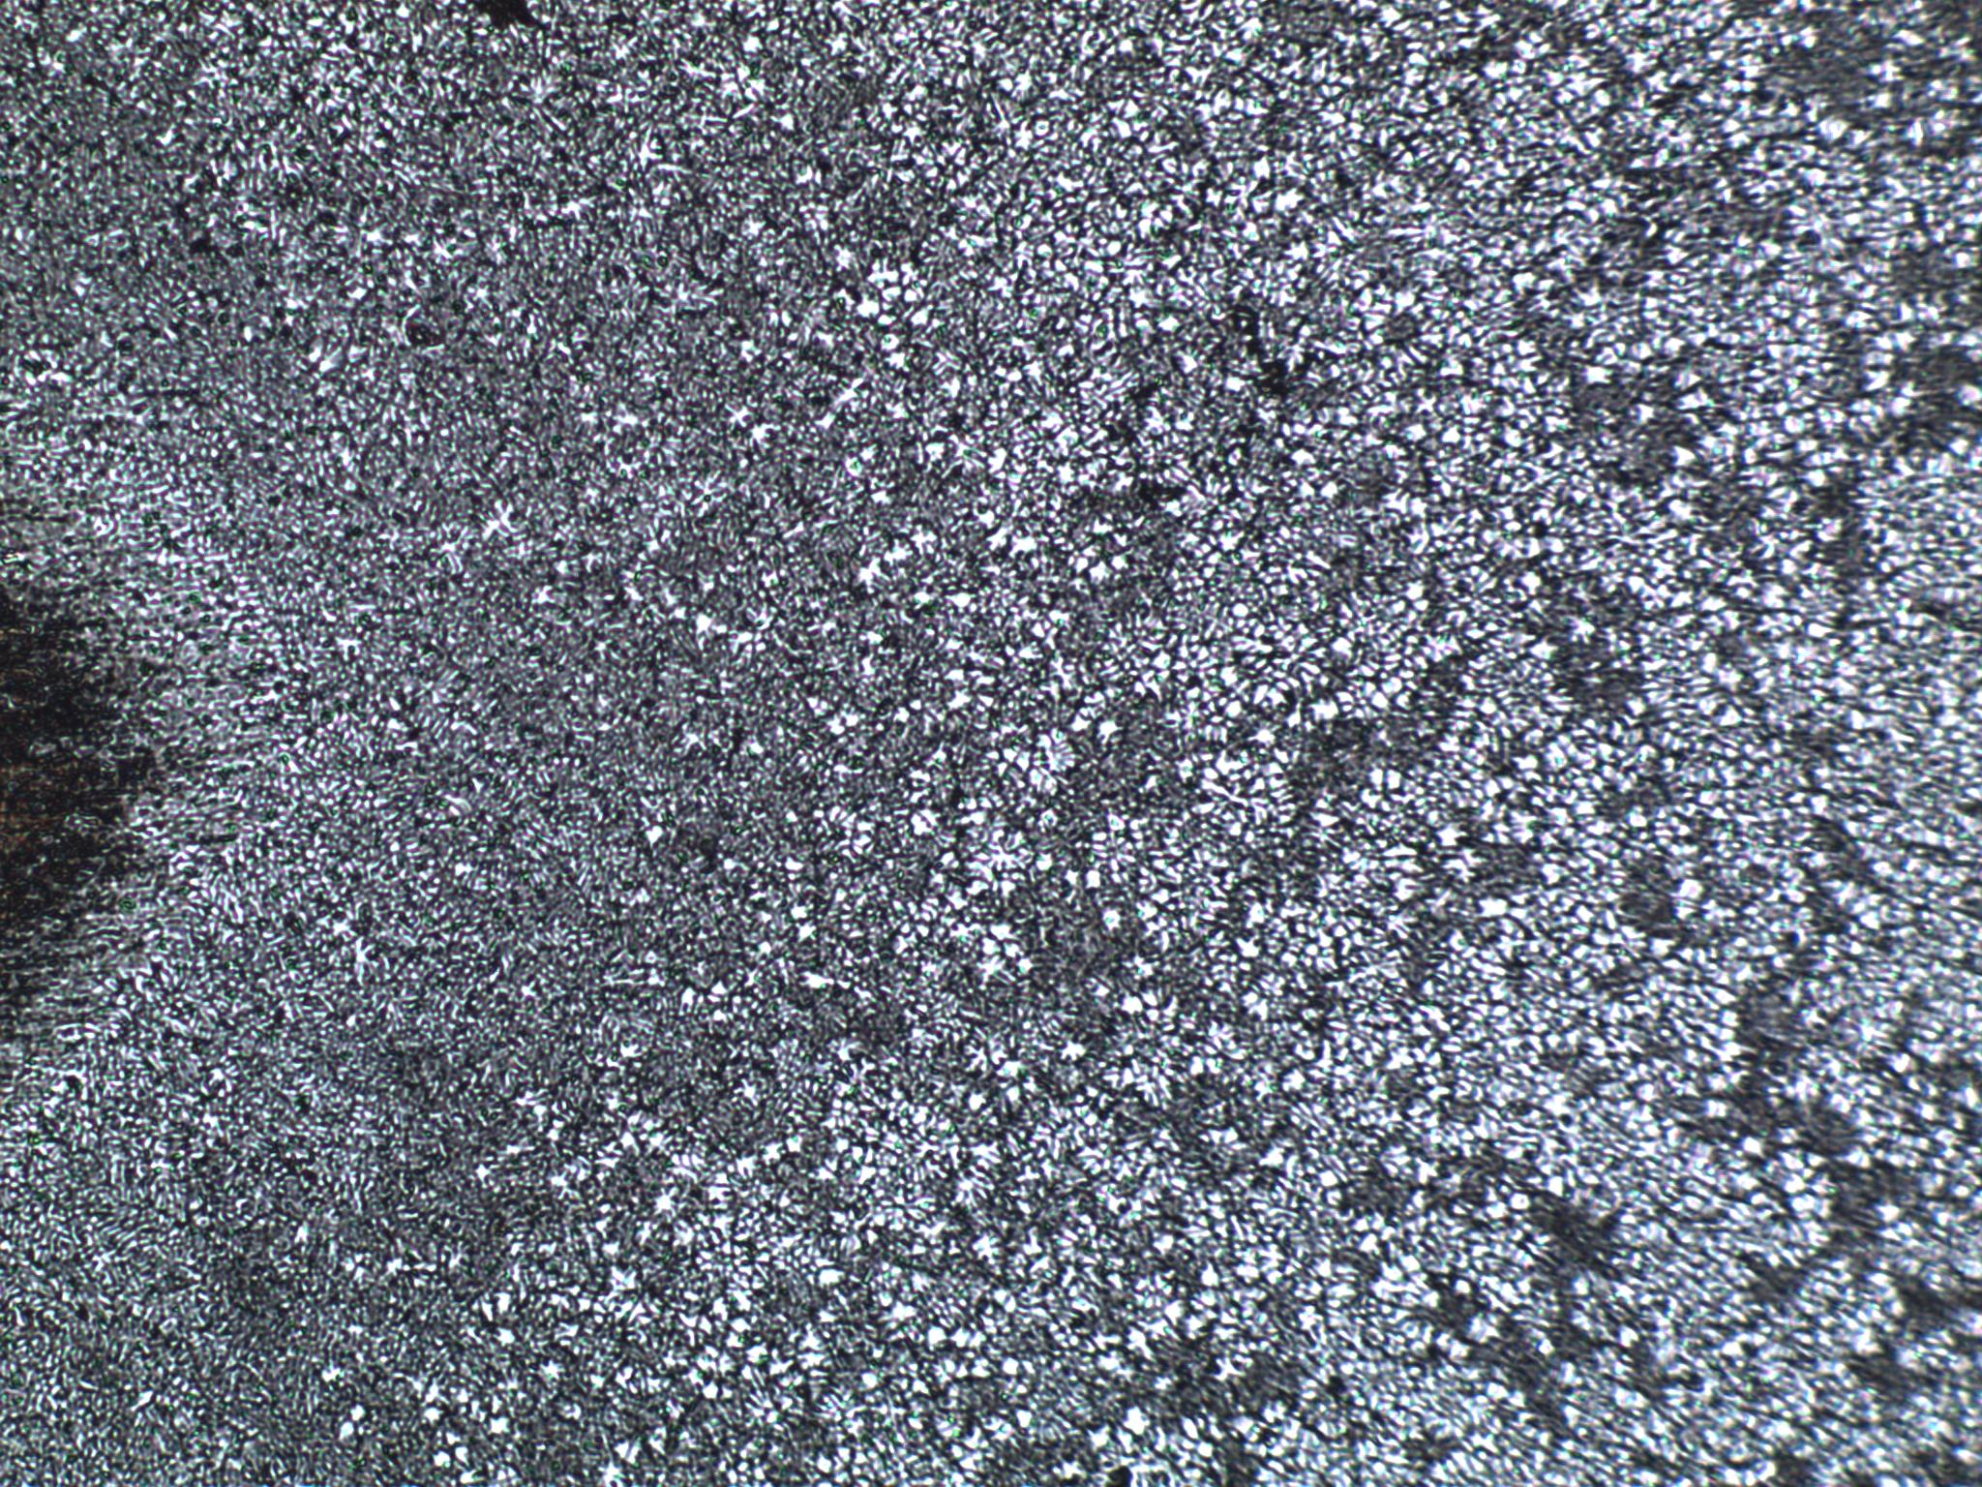
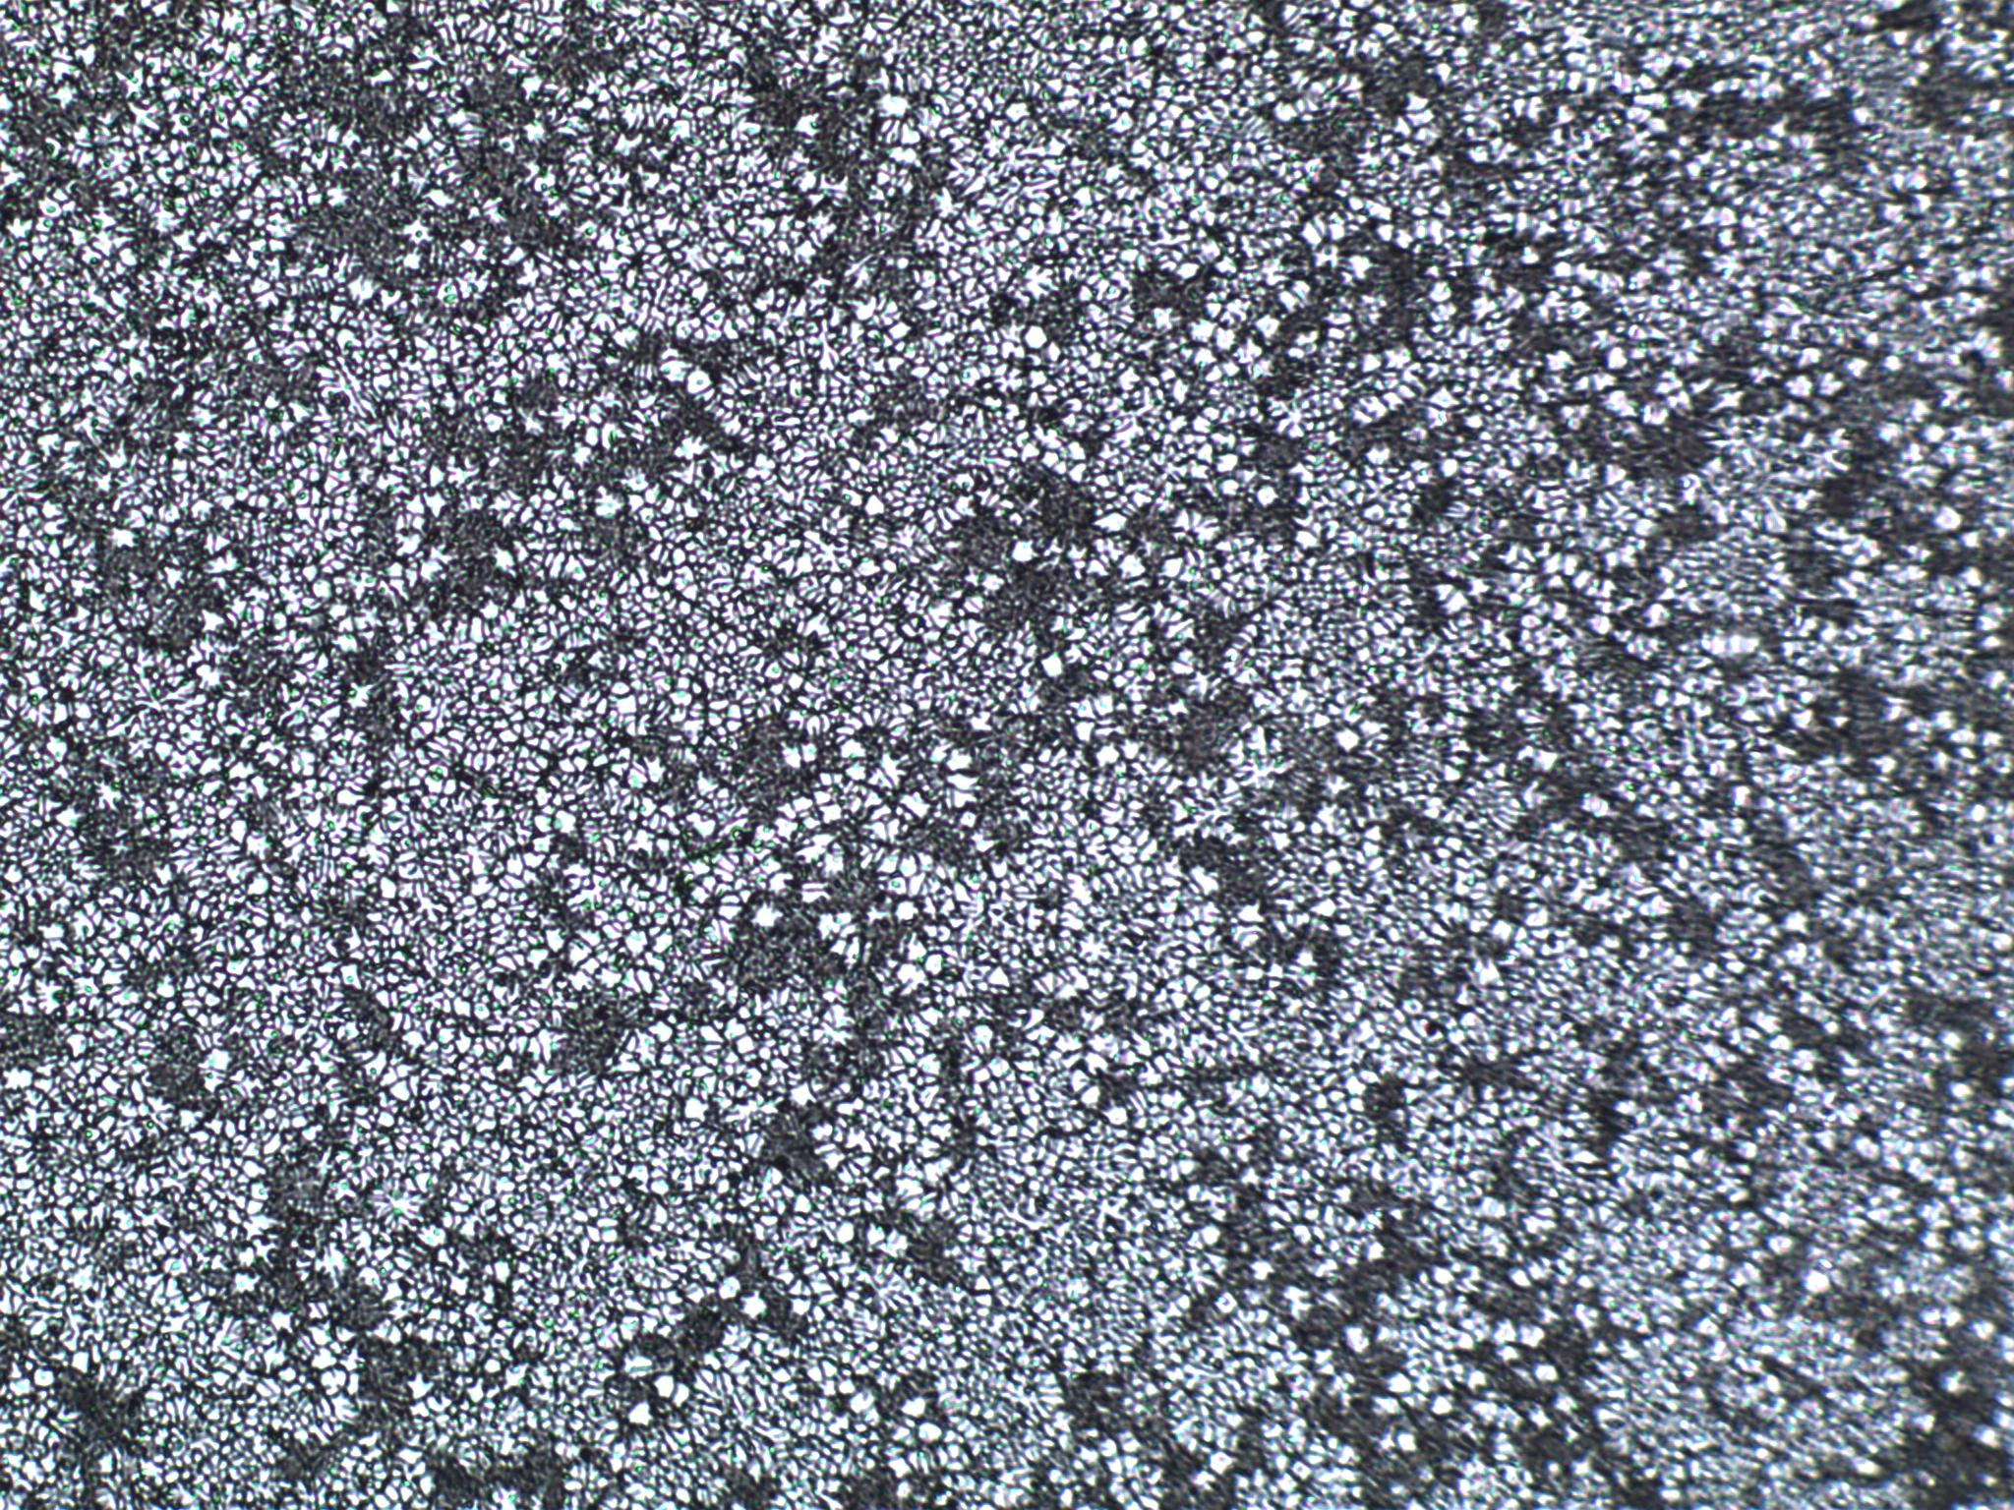
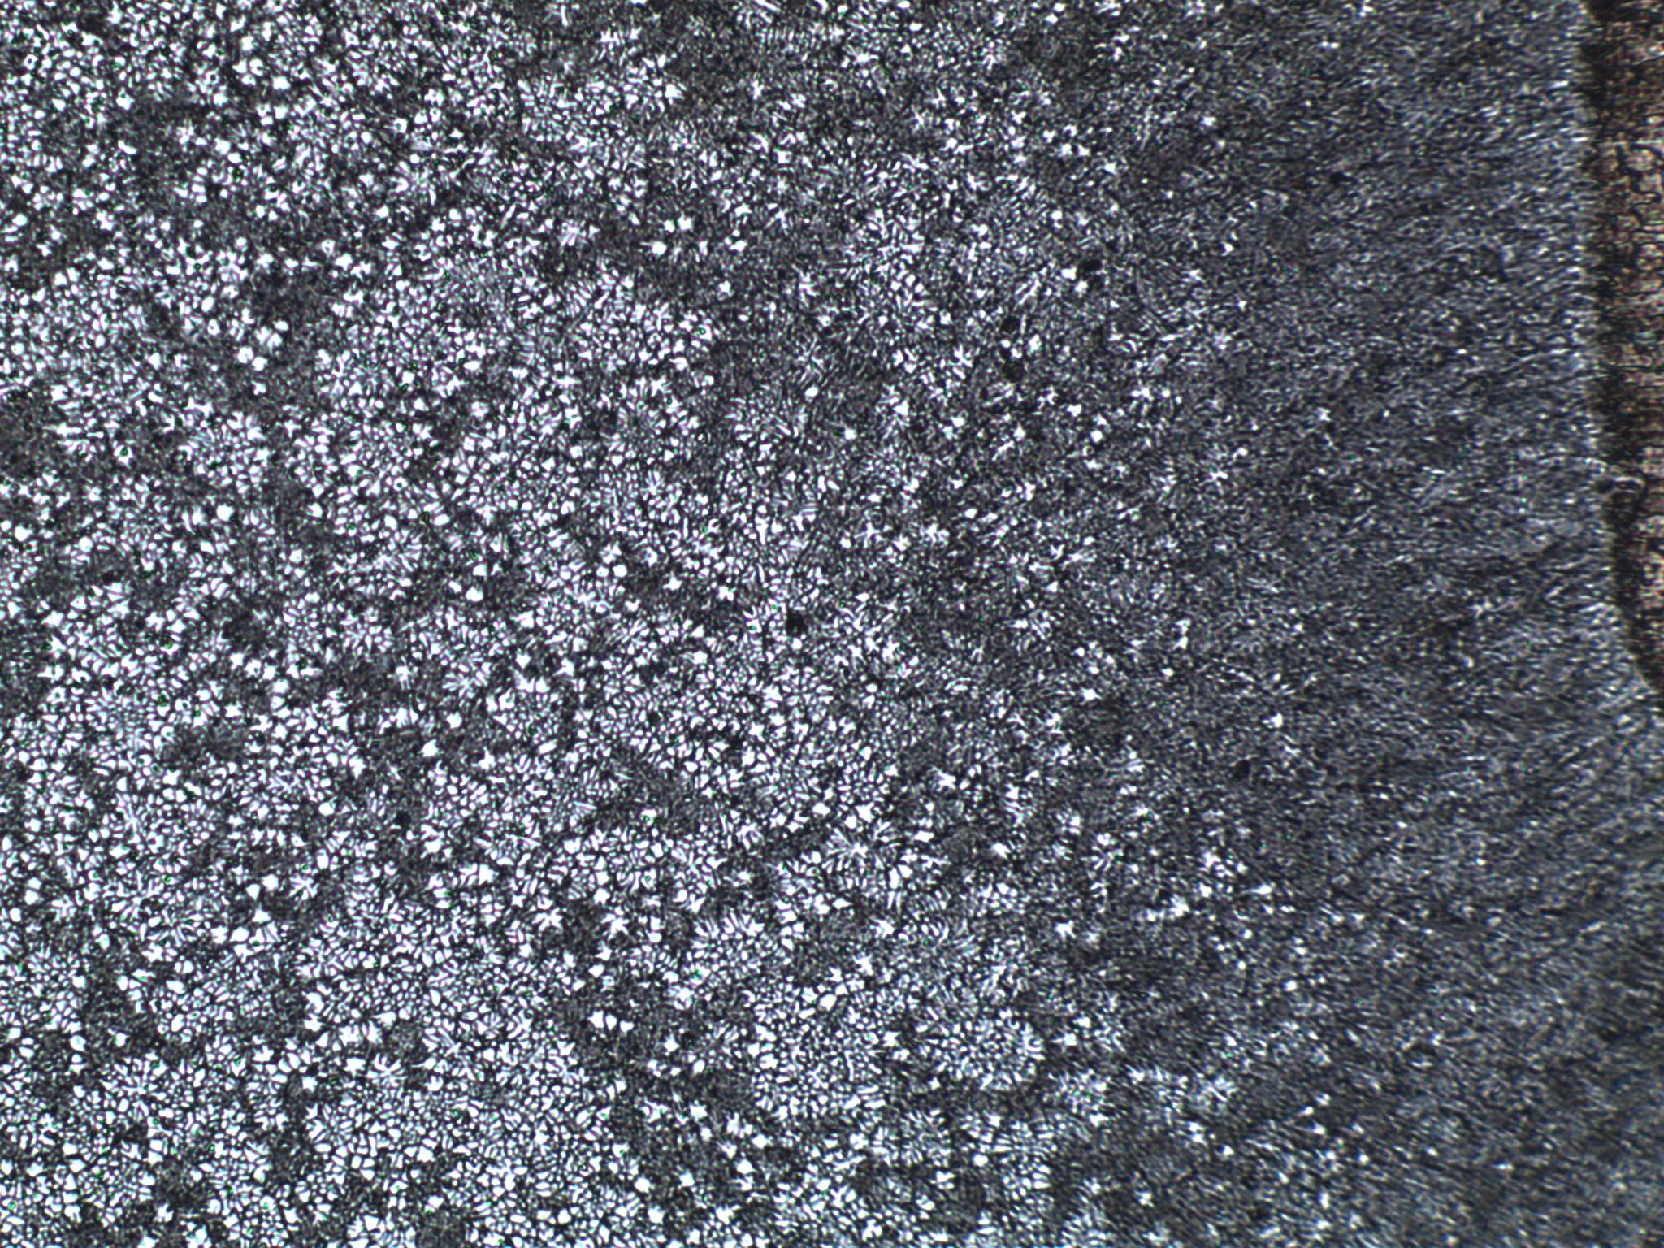
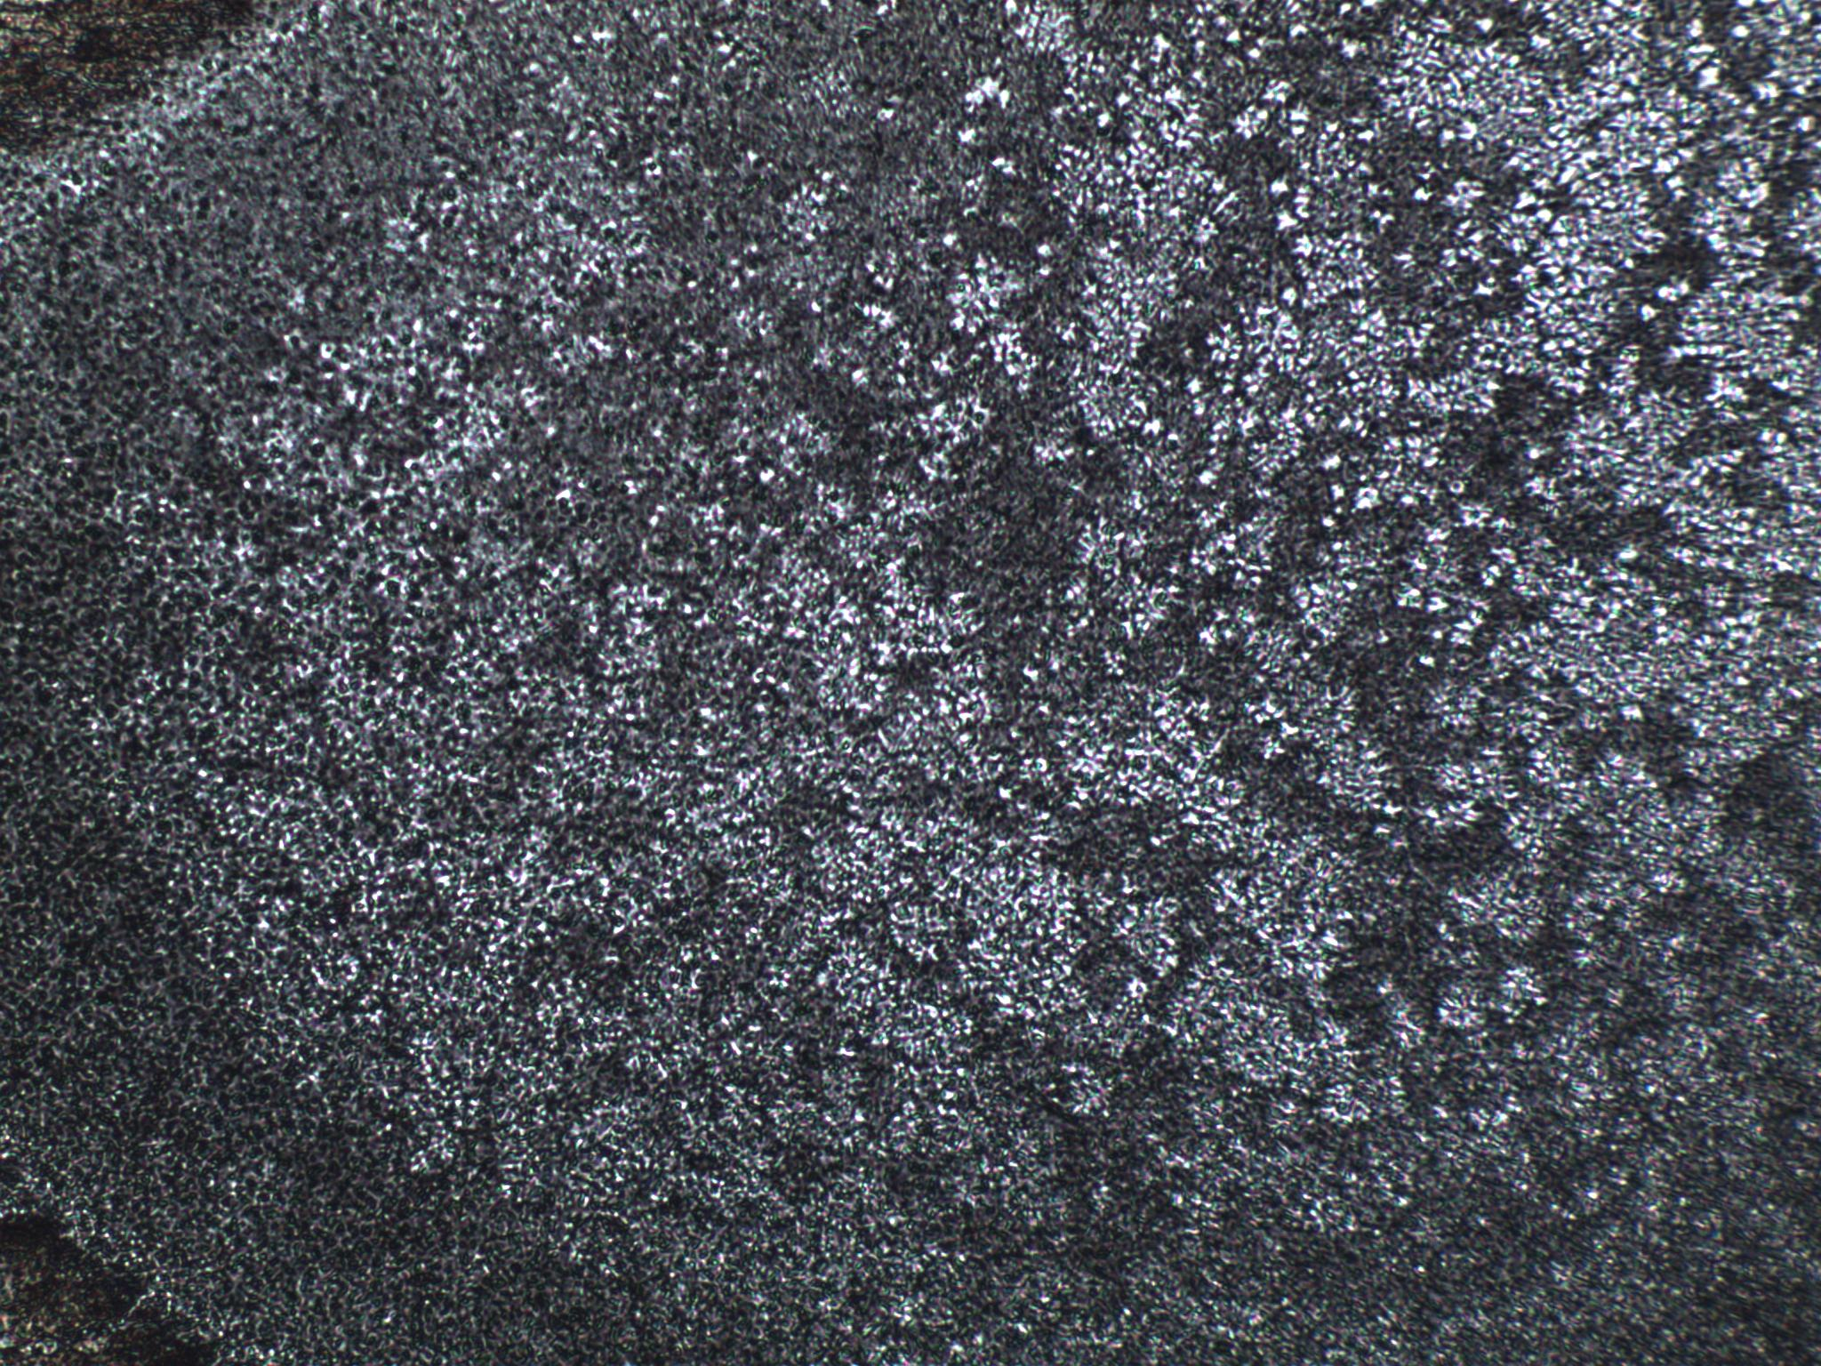
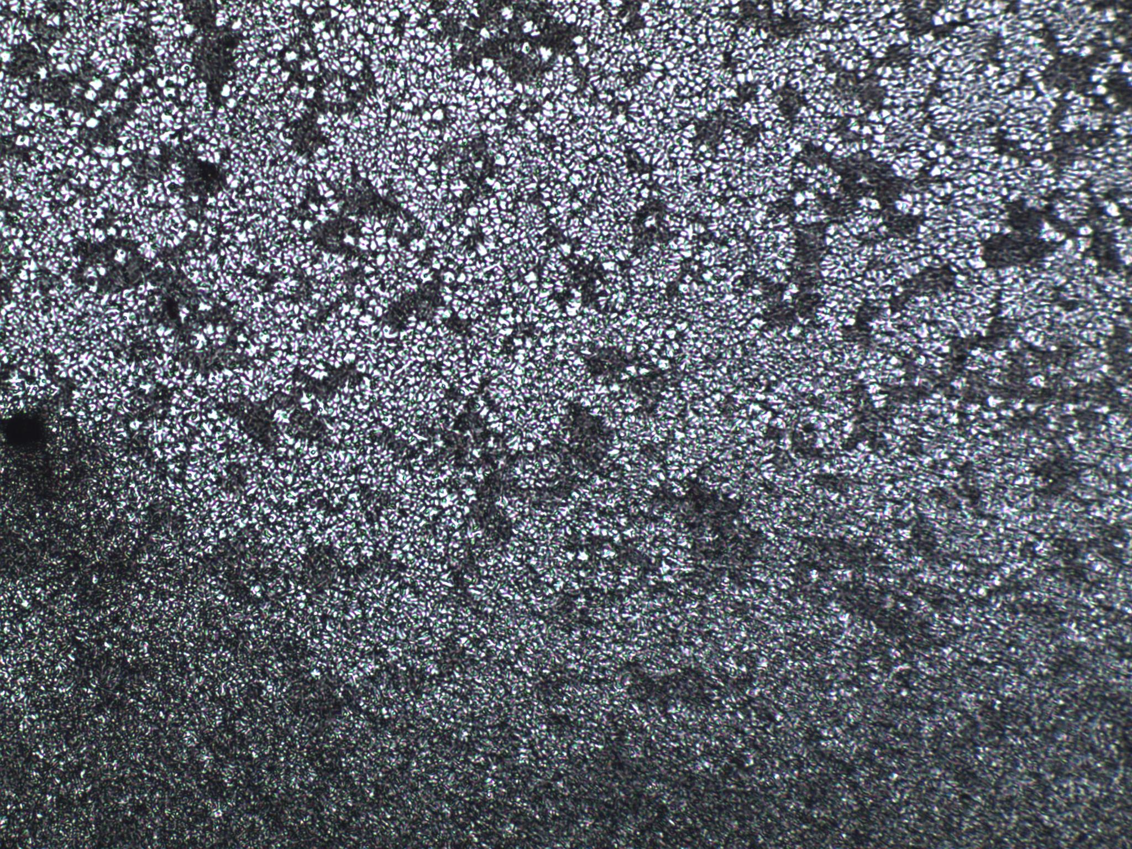
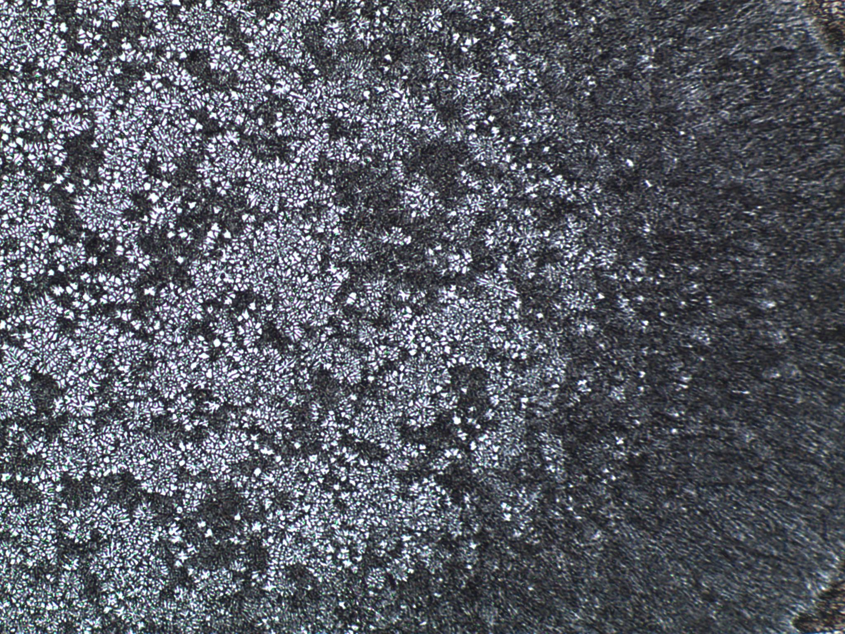
500 µm
1 mm

Slide 9
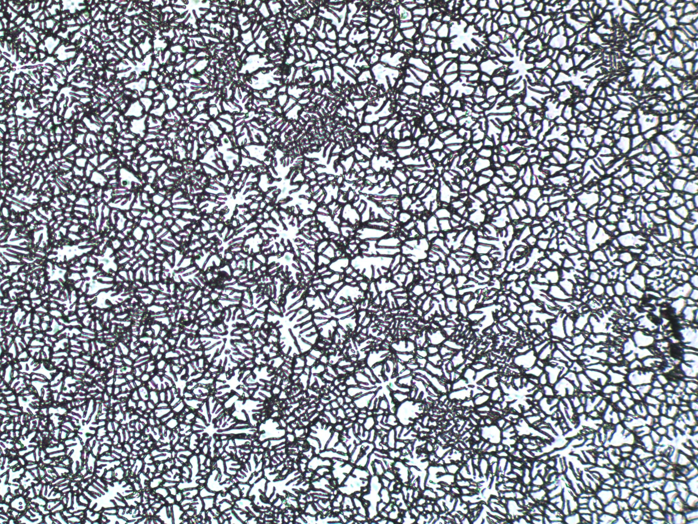
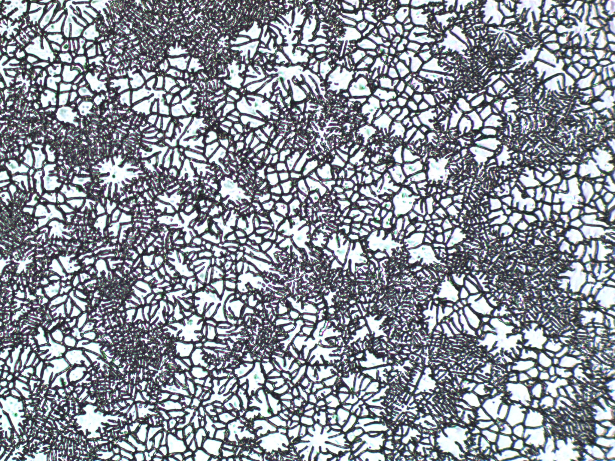
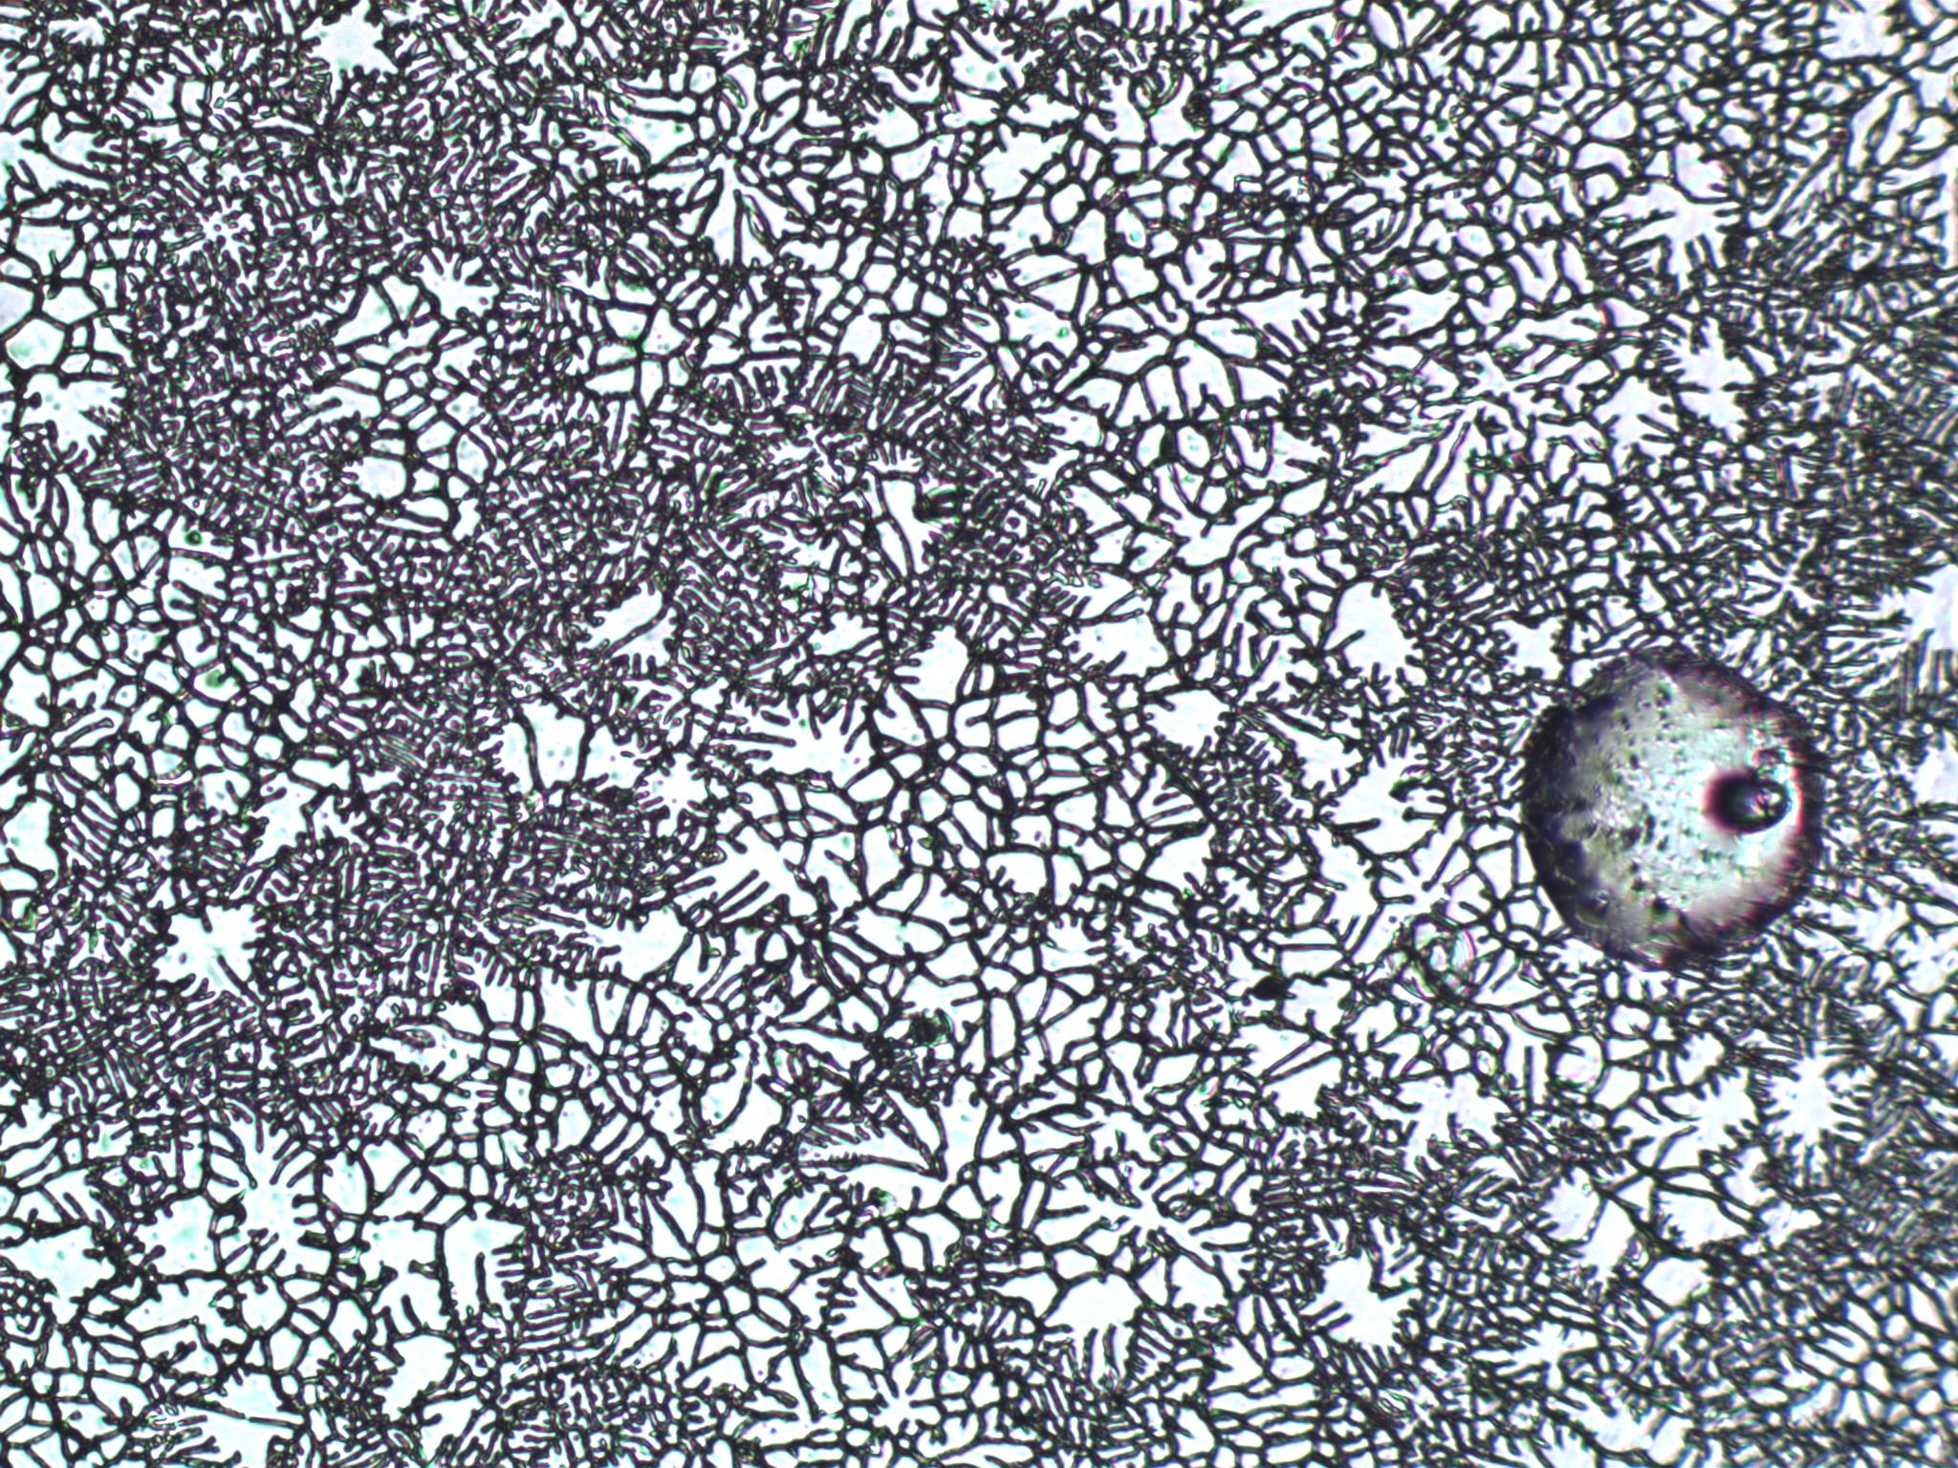
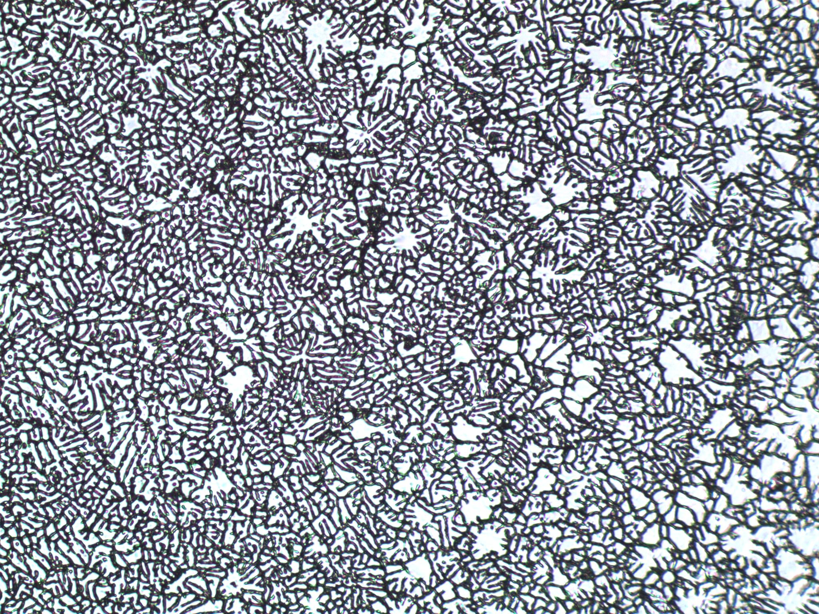
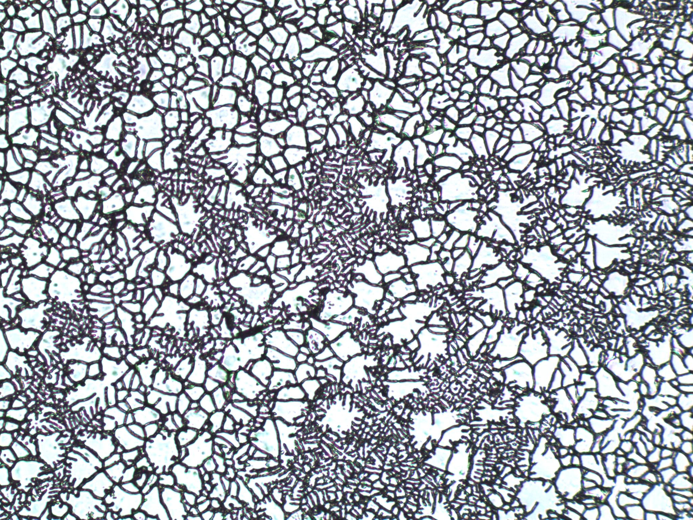
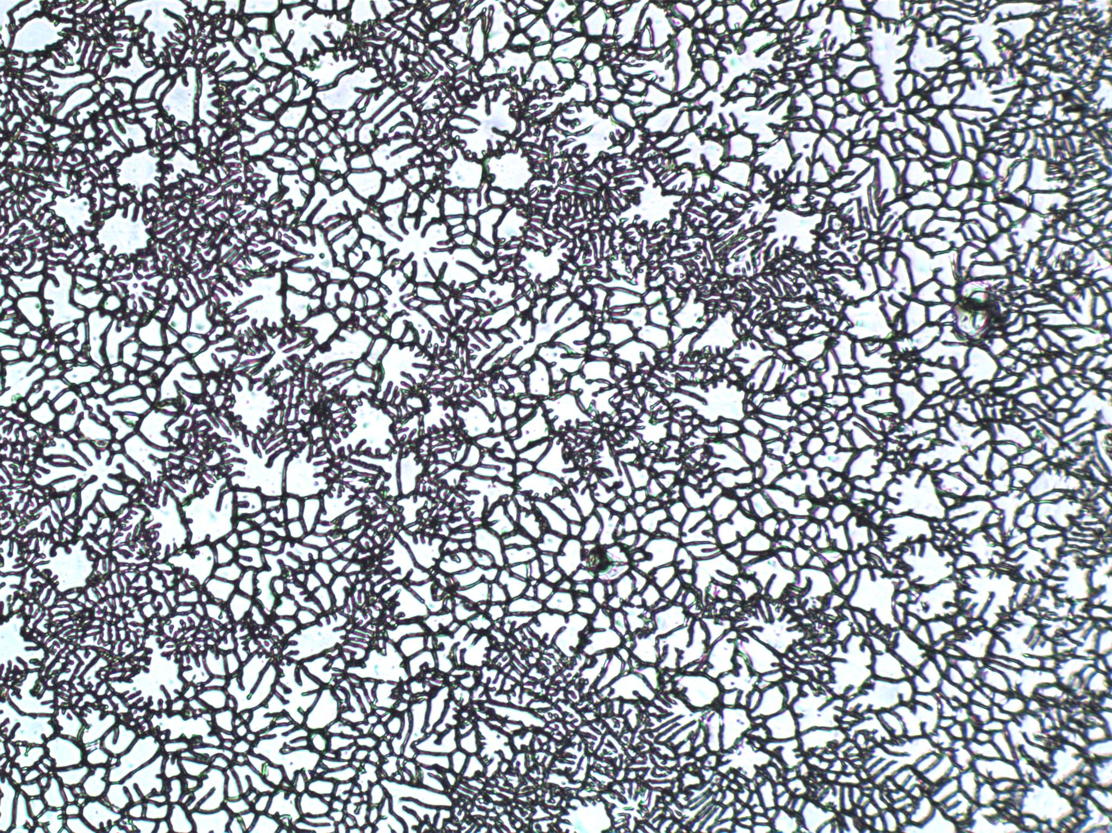
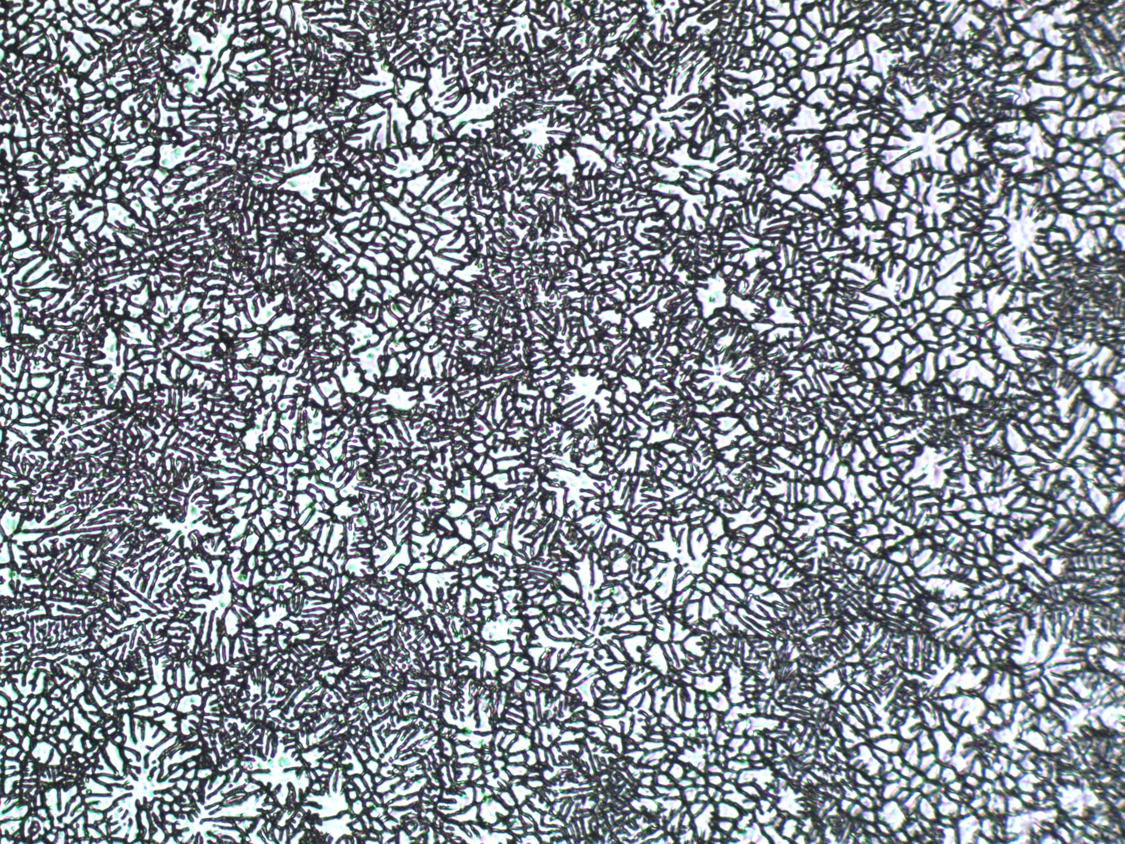
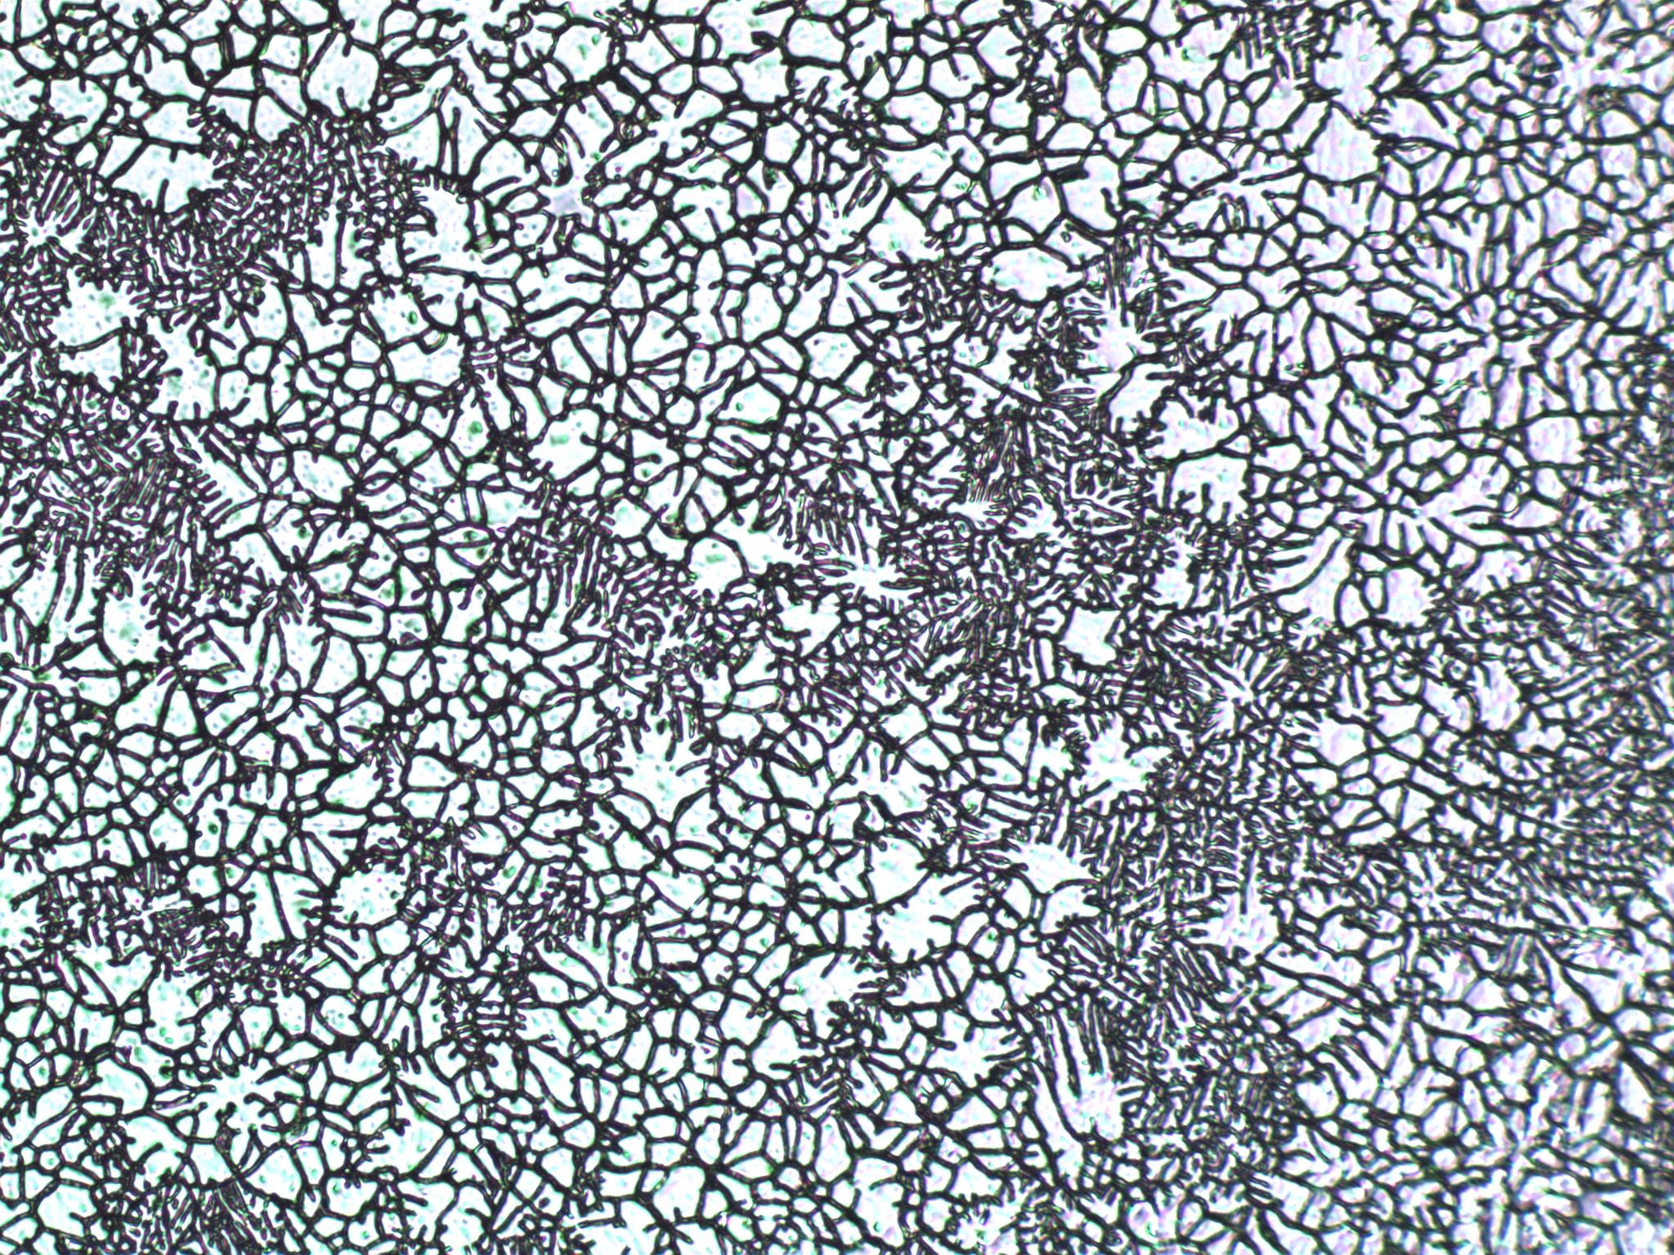
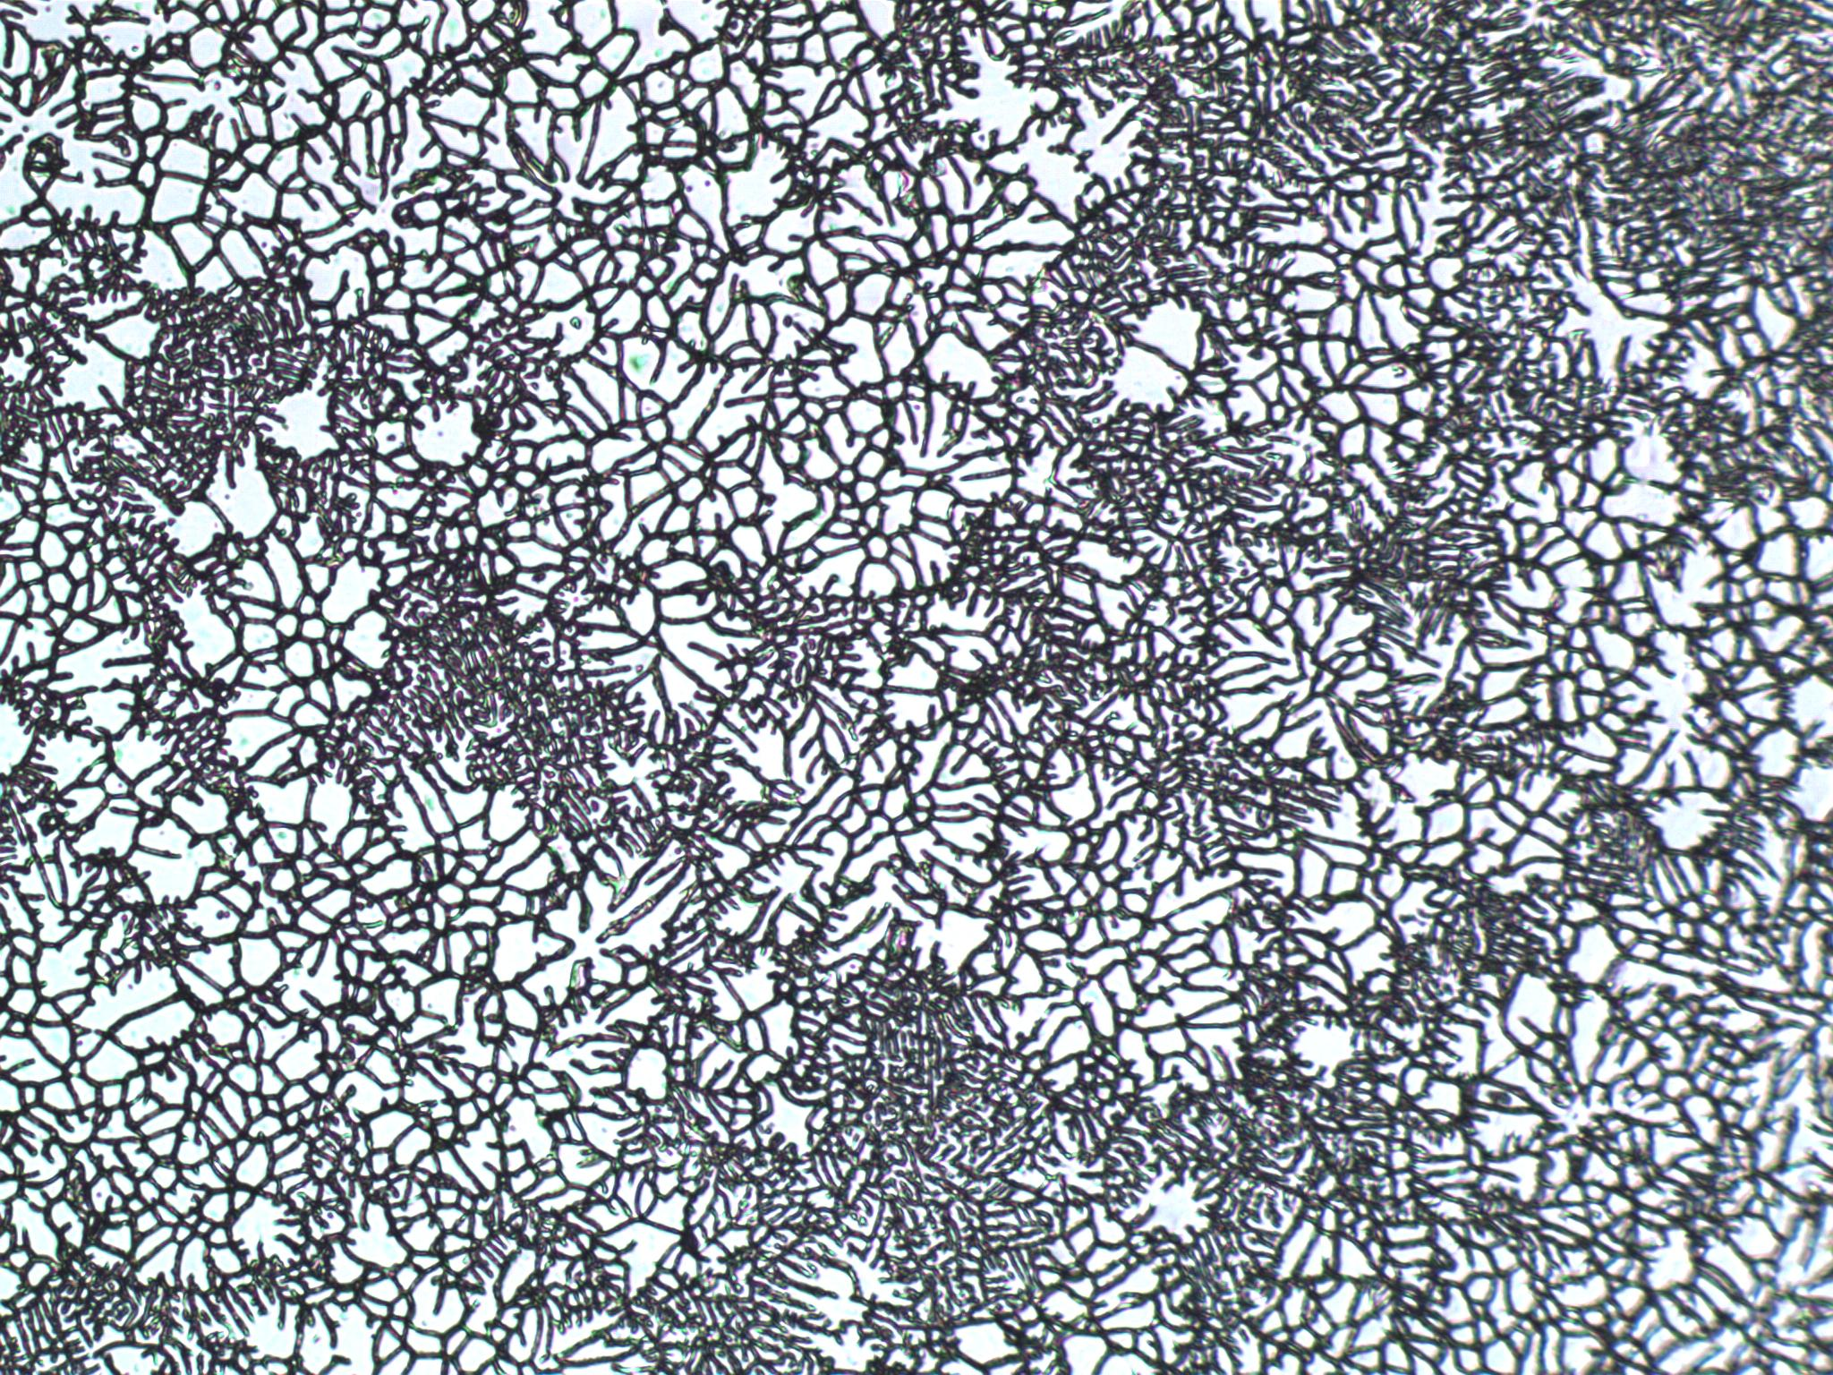
125 µm
1 mm

Slide 10
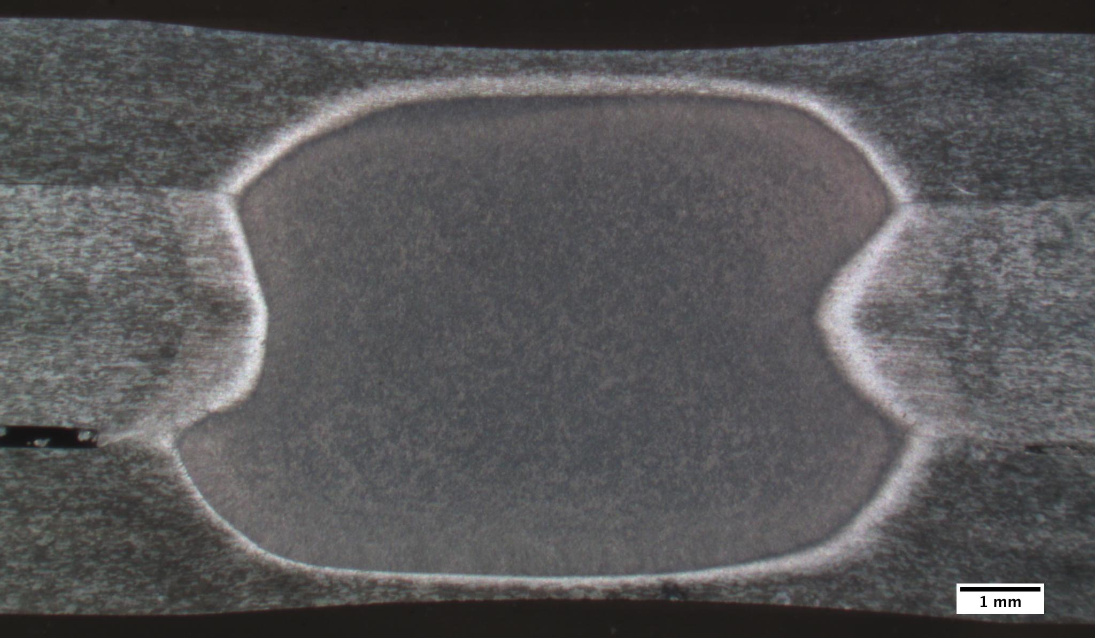
MicroHardness of RSW

Slide 11
MicroHardness of RSW

Slide 12
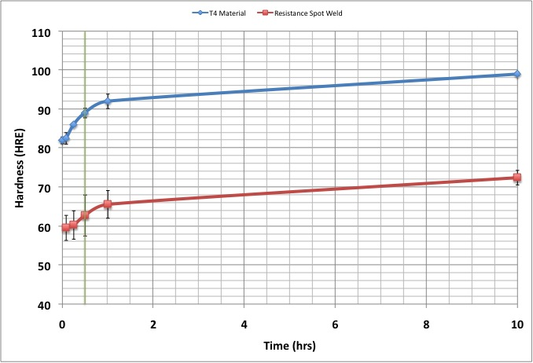
Artificial Aging of AA6111 at 180ºC: Rockwell Hardness E vs. Time
T4 Material*
Paint Baked
(Under Aged)
 | Hardness Values (HRE)
Time | T4* | Weld Spot
0 min | 82 | 59
5 min | 82.5 | 59.5
15 min | 86 | 60.25
30 min | 89 | 62.7
1 hr | 92 | 65.5
10 hr | 99 | 72.5
RSW Nugget
*Values converted from Rockwell B (HRB) data
Notes:
-hardness: materials resistance to plastic deformation
-crack growth is plastic process

Slide 13

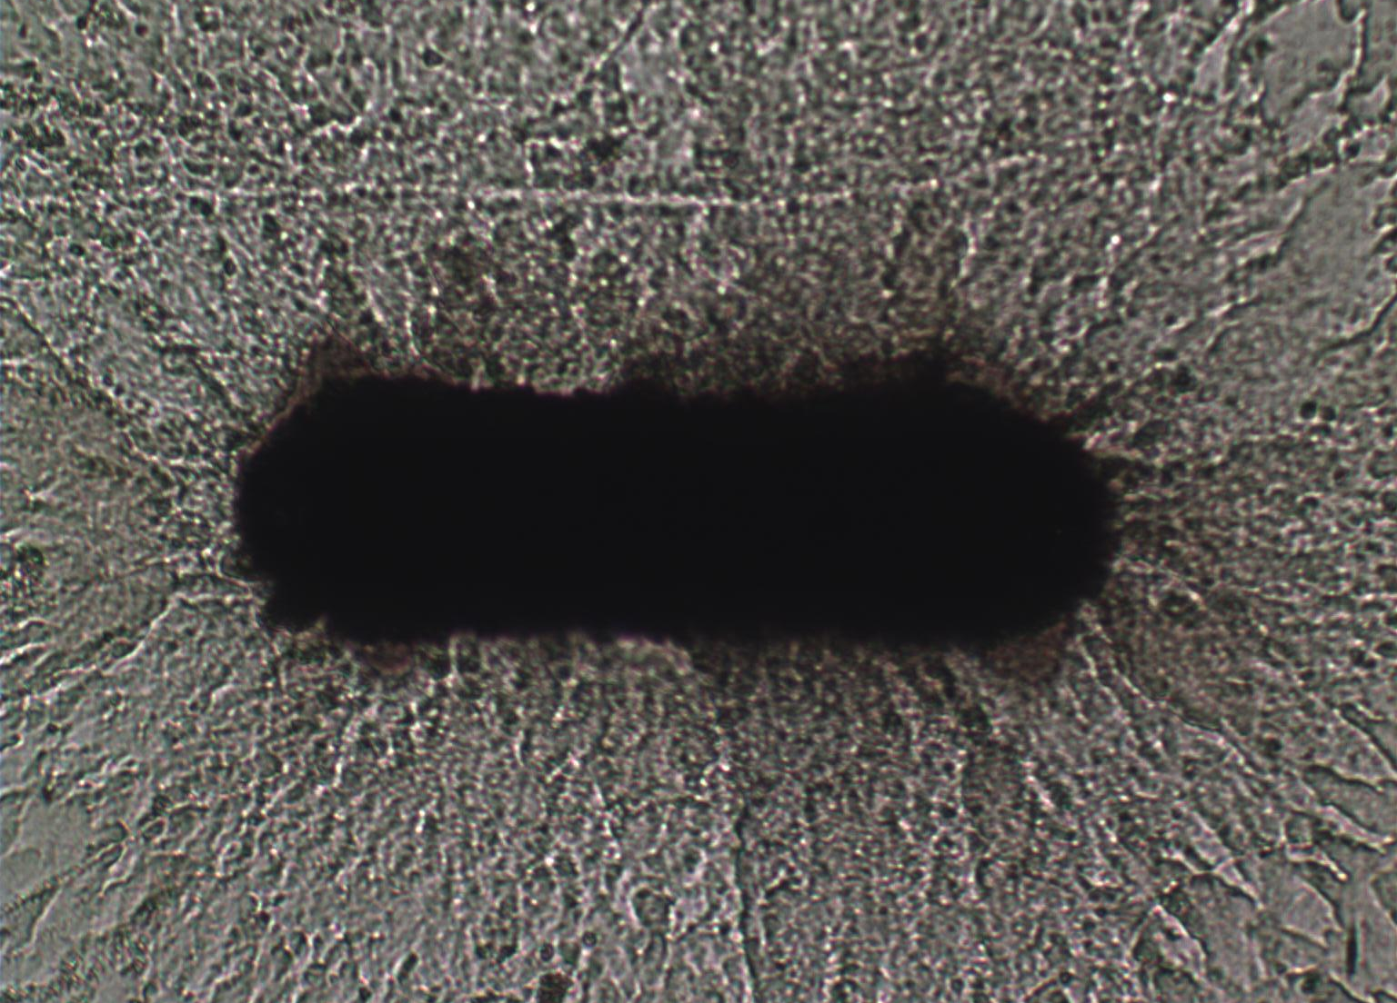
Femtosecond Sample Notching*
Loading
Direction
Apply notch to have favorable crack initiation site
50 J/cm², 150 fs pulse duration, 780 nm wavelength
150 µm
*Notching performed by Prof. Yalisove and Mike Abere at the University of Michigan- Ann Arbor Department of Materials Science and CUOS

Slide 14
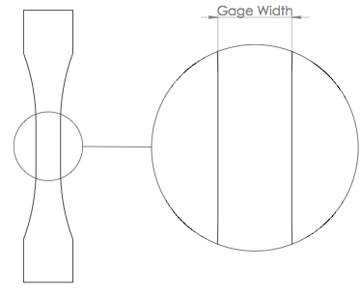
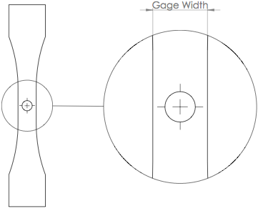
Notch Locations
T4 and Paint Bake Samples | Resistance Spot Weld Samples | Heat-Affected Zone Samples
Notch located in the middle of the T4 and PB samples | Notch in the middle of the Resistance Spot Weld | Notch located in the Heat-Affected Zone (HAZ)
Femtosecond Notch
(Red Rectangle)
Resistance Spot Weld Nugget
(Solid Circle)
Heat-Affected Zone
(Dashed Circle)

Slide 15
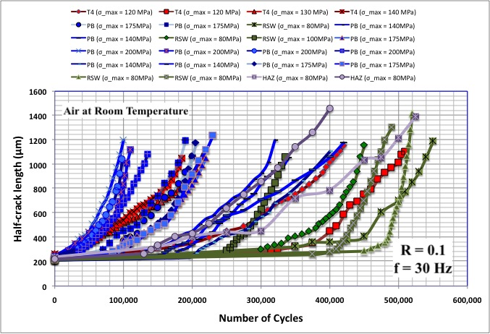
Half-Crack Length vs. Number of Cycles
T4 Samples
σ_{ys} = 179 MPa
120 MPa = 68% σ_{ys}
130 MPa = 74% σ_{ys}
140 MPa = 80% σ_{ys}
PB Samples
σ_{ys} = 247 MPa
140 MPa = 57% σ_{ys}
175 MPa = 70% σ_{ys}
200 MPa = 80% σ_{ys}
RSW Samples
σ_{ys} = 140 MPa*
80 MPa = 57% σ_{ys}
100 MPa = 71% σ_{ys}
HAZ Notched
σ_{ys} = 140 MPa*
80 MPa = 57% σ_{ys}
*Haggag, F. M., and G. C. Bell. "Measurement of Yield Strength and Flow Properties In Spot Welds and Their HAZs at Various Strain Rates." ASM 3rd International Conference on Trends in Welding Research (1992)
Notes:
-red initiates later, da/dN eventually converges

Slide 16
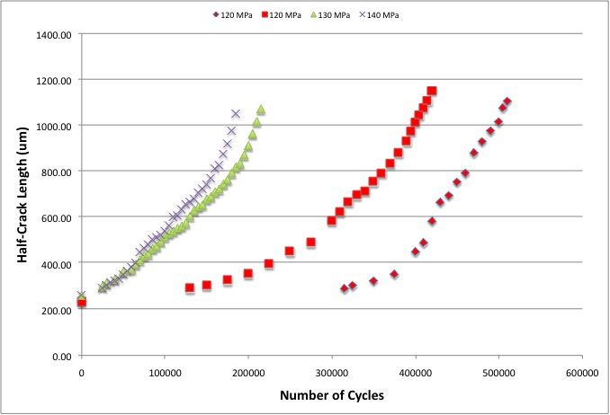
Half-Crack Length vs. Number of Cycles (T4)
σ_{max} = 140 MPa
σ_{max} = 130 MPa
T4 Samples
σ_{ys} = 179 MPa
120 MPa = 68% σ_{ys}
130 MPa = 74% σ_{ys}
140 MPa = 80% σ_{ys}
σ_{max} = 120 MPa
*Haggag, F. M., and G. C. Bell. "Measurement of Yield Strength and Flow Properties In Spot Welds and Their HAZs at Various Strain Rates." ASM 3rd International Conference on Trends in Welding Research (1992)
Notes:
-red initiates later, da/dN eventually converges

Slide 17
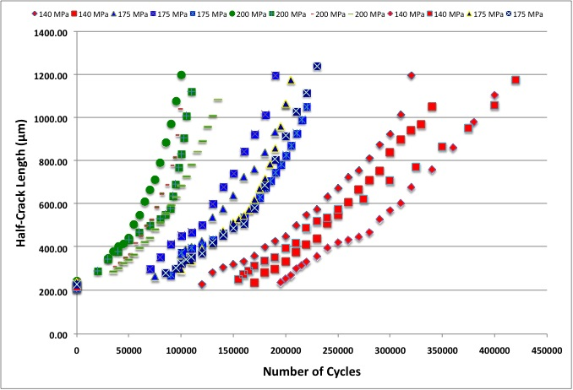
Half-Crack Length vs. Number of Cycles (PB)
σ_{max} = 175 MPa
σ_{max} = 200 MPa
PB Samples
σ_{ys} = 247 MPa
140 MPa = 57% σ_{ys}
175 MPa = 70% σ_{ys}
200 MPa = 80% σ_{ys}
σ_{max} = 140 MPa
*Haggag, F. M., and G. C. Bell. "Measurement of Yield Strength and Flow Properties In Spot Welds and Their HAZs at Various Strain Rates." ASM 3rd International Conference on Trends in Welding Research (1992)
Notes:
-red initiates later, da/dN eventually converges

Slide 18
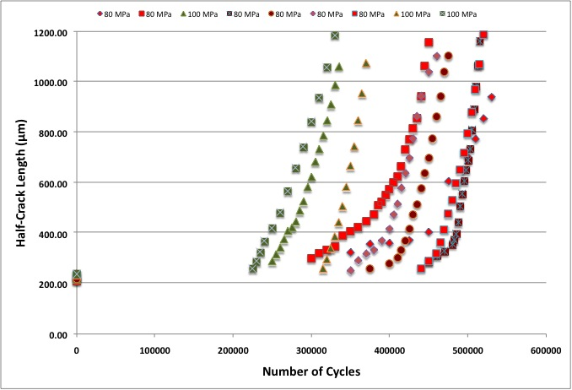
Half-Crack Length vs. Number of Cycles (PB RSW – Weld Nugget Notched)
σ_{max} = 100 MPa
(Notch in Center of Weld Nugget)
RSW Samples
σ_{ys} = 140 MPa*
80 MPa = 57% σ_{ys}
100 MPa = 71% σ_{ys}
σ_{max} = 80 MPa
(Notch in Center of Weld Nugget)
*Haggag, F. M., and G. C. Bell. "Measurement of Yield Strength and Flow Properties In Spot Welds and Their HAZs at Various Strain Rates." ASM 3rd International Conference on Trends in Welding Research (1992)
Notes:
-red initiates later, da/dN eventually converges

Slide 19
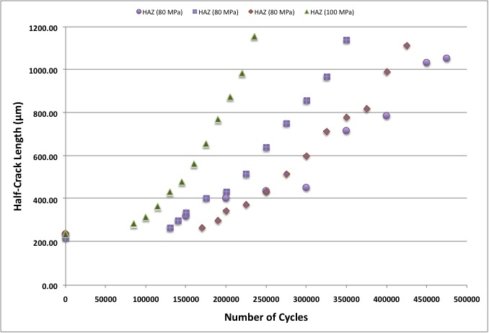
Half-Crack Length vs. Number of Cycles (PB RSW - HAZ Notched)
σ_{max} = 100 MPa
(Notch in Edge of Weld
Nugget/HAZ)
RSW Samples
σ_{ys} = 140 MPa*
80 MPa = 57% σ_{ys}
100 MPa = 71% σ_{ys}
σ_{max} = 80 MPa
(Notch in Edge of Weld Nugget/HAZ)
*Haggag, F. M., and G. C. Bell. "Measurement of Yield Strength and Flow Properties In Spot Welds and Their HAZs at Various Strain Rates." ASM 3rd International Conference on Trends in Welding Research (1992)
Notes:
-red initiates later, da/dN eventually converges

Slide 20
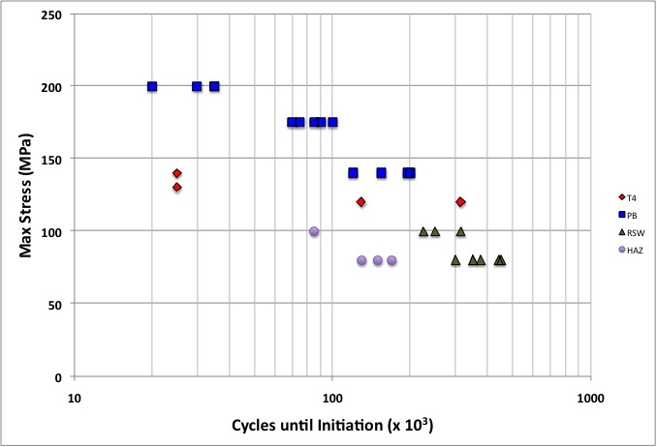
Crack Initiation vs. Maximum Stress

Slide 21
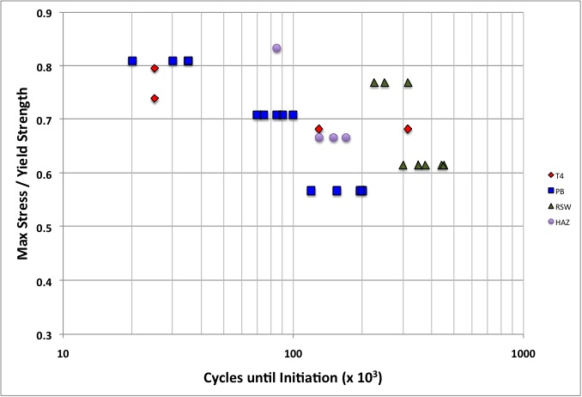
Crack Initiation vs. Maximum Stress

Slide 22
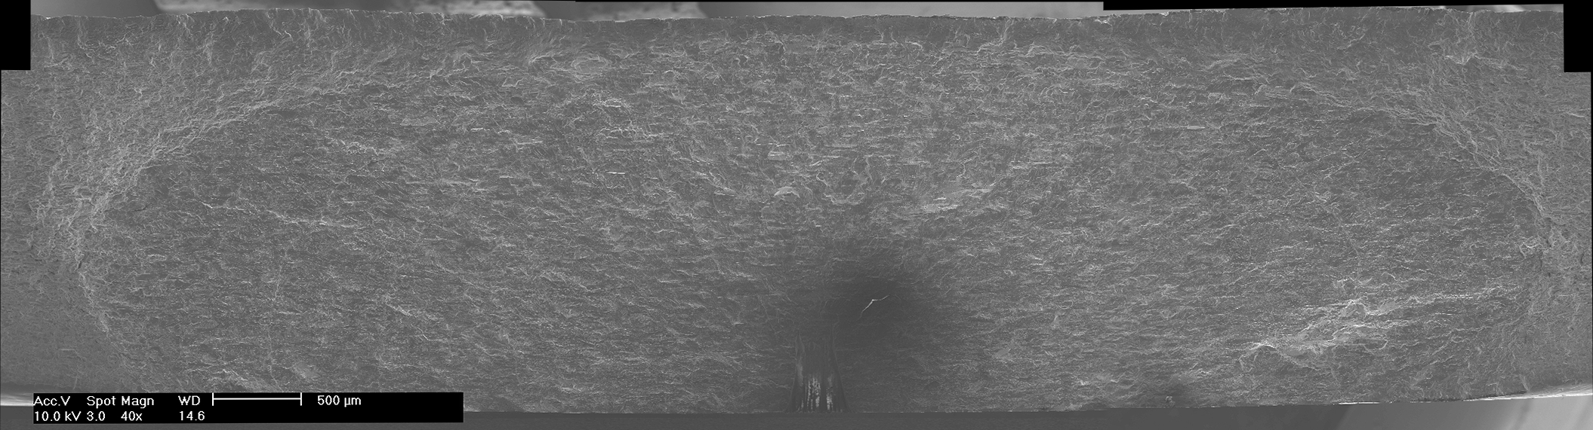
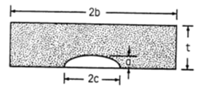
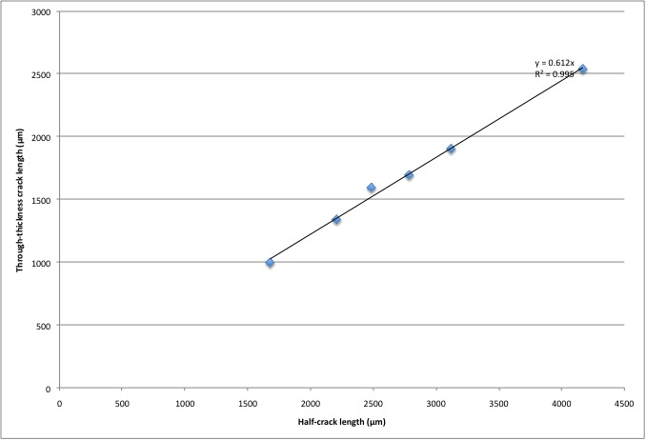
Crack Aspect Ratio
Calculate our a/c ratio in this case to be approximately 0.6

Slide 23
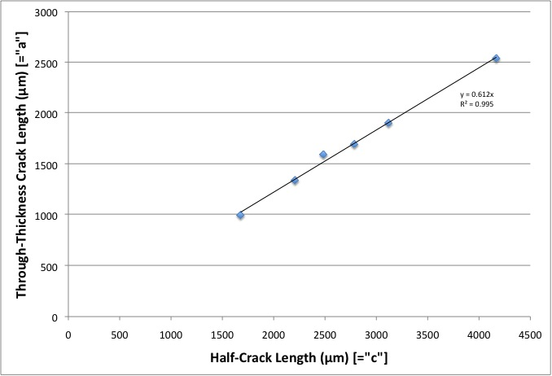
Crack Aspect Ratio: Measured “a” vs. measured “c”
-Ratio a/c remains
approximately constant
-Slope yields a/c = 0.612
Notes:
-increase font size

Slide 24
Stress Intensity Factor
Newman, J C, and I S Raju. “Stress-intensity factor equations for cracks in three-dimensional finite bodies subjected to tension and bending loads.” Nasa Technical Memorandum April (1984) : n. pag.

Slide 25
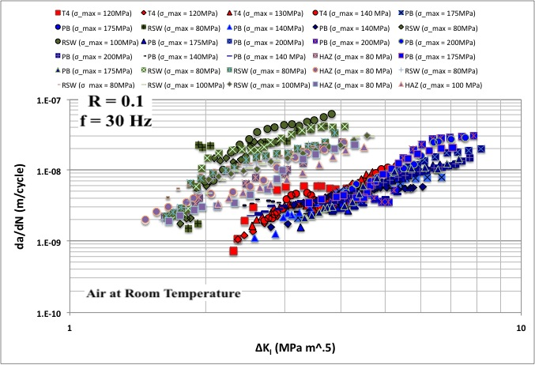
FCG Rate vs. Stress Intensity Factor
T4 Samples
σ_{ys} = 179 MPa
120 MPa = 68% σ_{ys}
130 MPa = 74% σ_{ys}
140 MPa = 80% σ_{ys}
Notch on Edge of WN / HAZ
PB Samples
σ_{ys} = 247 MPa
140 MPa = 57% σ_{ys}
175 MPa = 70% σ_{ys}
200 MPa = 80% σ_{ys}
Notch in Center of
Weld Nugget
RSW Samples
σ_{ys} = 140 MPa*
80 MPa = 57% σ_{ys}
100 MPa = 71% σ_{ys}
HAZ Notched
σ_{ys} = 140 MPa*
80 MPa = 57% σ_{ys}
*Haggag, F. M., and G. C. Bell. "Measurement of Yield Strength and Flow Properties In Spot Welds and Their HAZs at Various Strain Rates." ASM 3rd International Conference on Trends in Welding Research (1992)
Notes:
-no obvious stress level effect

Slide 26
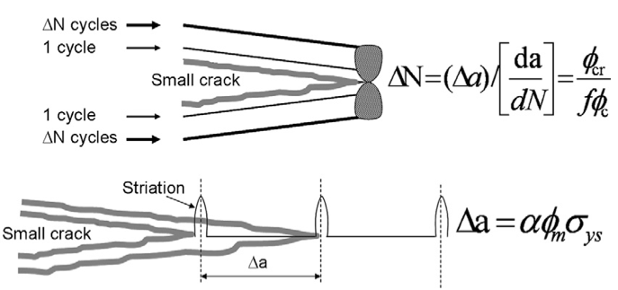
Small Crack Growth Model – “Shyam” Model*
Two Parameter Fatigue Crack-Growth Model
Analogous Relationship
for Small Cracks
where
(Monotonic Damage, Cyclic Damage)
f_{c} – cyclic crack-tip displacement
f_{m} – monotonic crack-tip displacement
f – slip irreversibility factor
f_{cr} – critical opening displacement
a – geometric scaling factor
*A. Shyam et al., Acta Materialia 55 (2007) 6606–6616
Notes:
-da/dN product of monotonic/cyclic damage accumulation
-CTOD terms come from BCS analysis
-u->damage susceptibility parameter (rate at which damage accumulation & crack advance can occur in a given microstructure ahead of crack tip

Slide 27
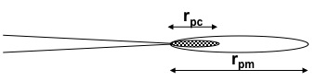
BCS* Theory Crack Growth Characterization Parameters
Crack tip displacements (for distribution of edge dislocations at crack tip)**
Monotonic Crack Tip Displacement
Cyclic Crack Tip Displacement
* Bilby BA, Cottrell AH, Swinden KH. Proc Royal Soc A 1963;272:304.
** Weertman J. “Dislocations Based Fracture Mechanics”
Notes:
-dislocation density at tip of crack is high -> can be represented by continuous distribution function
-note B: Bilby, C: Cottrell, S: Swinden

Slide 28
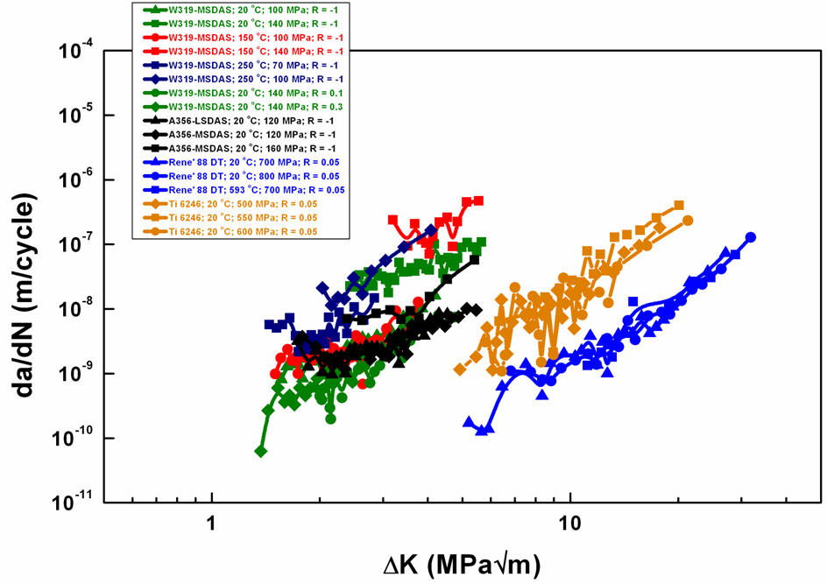
Small FCP Curves*
Cast Al Alloys
Ti-6246
Rene’ 88
*A. Shyam et al., Acta Materialia 55 (2007) 6606–6616

Slide 29
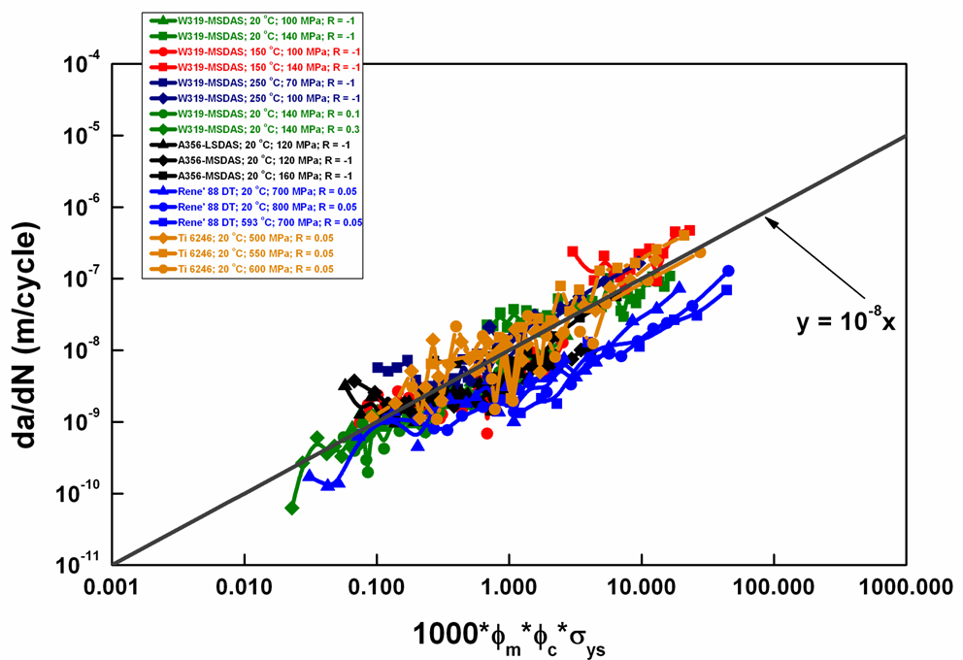
Application of the Model*
*A. Shyam et al., Acta Materialia 55 (2007) 6606–6616
Notes:
~4 orders of magnitude

Slide 30
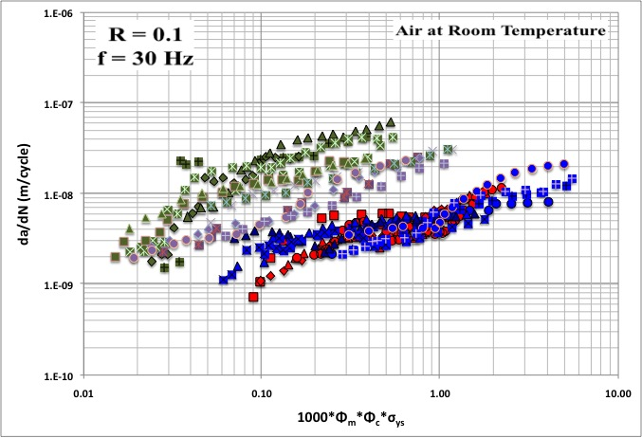
“Shyam” Parameter
T4 Samples
σ_{ys} = 179 MPa
120 MPa = 68% σ_{ys}
130 MPa = 74% σ_{ys}
140 MPa = 80% σ_{ys}
Notch in Center of
Weld Nugget
Notch on Edge of WN / HAZ
PB Samples
σ_{ys} = 247 MPa
140 MPa = 57% σ_{ys}
175 MPa = 70% σ_{ys}
200 MPa = 80% σ_{ys}
RSW Samples
σ_{ys} = 140 MPa*
80 MPa = 57% σ_{ys}
100 MPa = 71% σ_{ys}
HAZ Notched
σ_{ys} = 140 MPa*
80 MPa = 57% σ_{ys}
*Haggag, F. M., and G. C. Bell. "Measurement of Yield Strength and Flow Properties In Spot Welds and Their HAZs at Various Strain Rates." ASM 3rd International Conference on Trends in Welding Research (1992)
Notes:
da/dN = u(phi_m*phi_c*sig_ys)^m2
-reiterate only 1 order of magnitude

Slide 31
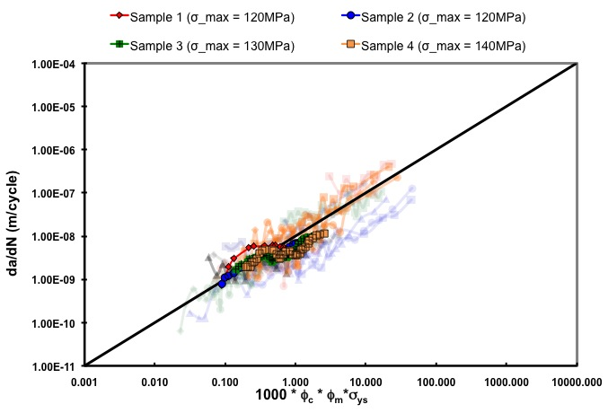
“Shyam” Parameter Comparison (T4)
y = 1E-8x
Notes:
-show the order of magnitude change

Slide 32

“Shyam” Parameter Comparison (PB)
y = 1E-8x
Notes:
-show the order of magnitude change

Slide 33

“Shyam” Parameter Comparison (RSW Weld Nugget Notched)
y = 1E-8x
Notch in Center of
Weld Nugget
Notes:
-show the order of magnitude change

Slide 34

“Shyam” Parameter Comparison (RSW HAZ Notch)
y = 1E-8x
Notch on Edge of
WN / HAZ
Notes:
-show the order of magnitude change

Slide 35

“Shyam” Model Intercept for RSW
y = 1E-7x
y = 1E-8x

Slide 36
“Shyam” Model Intercept for RSW
Damage Susceptibility Parameter, μ, is the intercept of the Shyam equation
μ_{T4/PB} ≅ 10⁻⁵ and μ_{RSW} ≅ 10⁻⁴
Shyam model journal paper has 2.39E-6 < μ < 1.97E-5 for his samples
Would need our slip irreversibility (f) to decrease or have our critical crack-tip opening displacement increase to yield an order of magnitude decrease in our DSP

Slide 37
Self Initiated Crack in Weld Zone
Sample notched in heat-affected zone
After fatiguing to small-crack threshold, noticed a self-initiated crack in the middle of the weld region
Continued fatiguing sample and monitored crack growth of HAZ crack and self-initiated crack
Heat-Affected Zone
(Dashed Circle)

Slide 38

Tension Testing
Followed ASTM E8 Standards for tension testing of metallic materials
Used an MTS extensometer (model 632.11B-20) to measure the strain
Rated for +/- 3.8 mm
Actuator moved at 0.01 mm/sec (yielding 0.01667 mm/mm / min – following ASTM standards)
Measured yield strength using the offset method

Slide 39

Elastic Modulii are similar
E_{T4} = 69.3±1.8 GPa; E_{PB} = 68.4±1.9 GPa
Yield Strength clearly higher in PB than T4
σ_{y,T4} = 179±4 MPa; σ_{y,PB} = 247±3 MPa
Tensile Strength:
σ_{TS,T4} = 311±9 MPa; σ_{TS,PB} = 349±5 MPa
Uniform Elongation:
ε_{U,T4} = 0.23±0.01; ε_{U,PB} = 0.21±0.01
Work Hardening Exponent
n_{T4} = 0.21±0.01; n_{PB} = 0.19±0.01
Notes:
-have text overlay after init graph

Slide 40

MicroTensile Samples

Slide 41

MicroTensile Samples

Slide 42
Immediate Plans
Determine elastic modulus and yield strength of the weld nugget from monotonic tension testing of the microtensile samples
Finish testing a few additional WN / HAZ notched samples at 80 and 100 MPa
Complete data analysis for thesis completion

Slide 43
Acknowledgements
Ford Motor Company
Mei Li
Elizabeth Hetrick
John Lasecki
Xu Ming Su
Larry Godlewski
University of Michigan
Alfred Okello
Jason Geathers
Tracy Berman
Jiashi Miao
Xianfeng Ma
Prof. Steven Yalisove
Mike Abere

